Slide 1


BTech IV Year VII Semester Section: B
BCSE0103: SOFT COMPUTING: Fuzzy Logic
Dr. Dilip Kumar Sharma
SM(IEEE, ACM, CSI), Fellow IETE, Fellow IE(I)
Professor- Dept. of Computer Engineering & Applications
Dean (International Relations & Academic Collaborations)
GLA University, Mathura, INDIA
Email: dilip.sharma@gla.ac.in
https://www.gla.ac.in/academics/faculty-detail/7/prof-dilip-kumar-sharma

Slide 2
BCSE0103: SOFT COMPUTING
Objective: Students will get an insight of the intelligent computational approaches. Providing students, the mathematical background to carry out optimization.
Neural Networks: Introduction to Soft Computing & Neural Computing, Fundamentals of Artificial Neural Network(ANN), Models of ANN, ANN models: Rosenblatt’s Perception, McCulloch & Pitts Model, Single Layer Perceptron, Learning Methods in Perceptron, Linearly Separable Task and XOR Problem, Multi-Layer Perceptron, Back Propagation Learning Algorithm, Associative Memory: Hopfield network, Auto Associative Memory, Bidirectional Hetro-Associative Memory, ADALINE, MADALINE Network, Applications of Neural Network.
Fuzzy Logic: Introduction to Fuzzy Sets & Crisp Sets, Fuzzy Membership and Fuzzy Operations, Properties of Fuzzy Sets- Linguistic Hedges, Fuzzy Logic – T-norms and other aggregation operators, Crisp Relations.

Slide 3
BCSE0103: SOFT COMPUTING
Fuzzy Logic: Fuzzy Relations, Fuzzy System, Crisp Logic, Propositional Logic and its Laws, Inference in Propositional Logic, Fuzzy Logic, Inference in Fuzzy Logic (GMP and GMT), Fuzzy Rule Based System, Fuzzyfication & Defuzzification, Applications of Fuzzy Logic.
Genetic Algorithm(GA):Introduction to GA, Search optimization Method, Evolutionary Algorithm Working Principle, Biological Background of GA, Working Principles of GA, Encoding(Binary, Value, Permutation, Tree), Operators of GA(Random Population, Reproduction or Selection), Crossover and Mutation, Basics of Genetic Algorithm with Examples, Introduction to Genetic programming
Text Books:
S. Rajsekaran& G.A. VijayalakshmiPai, “Neural Networks, Fuzzy Logic and Genetic Algorithm: Synthesis and Applications”, 4th Edition, Prentice Hall of India,2003.

Slide 4
BCSE0103: SOFT COMPUTING
Reference Books:
Timothy J Ross ,"Fuzzy Logic with Engineering Applications", 3rd Edition, John Wiley and Sons,2016.
David E. Goldberg ,"Genetic Algorithm in Search Optimization and Machine Learning "Adission-Wesley,2009.
Karray, “Soft Computing and Intelligent Systems Design: Theory, Tools and Applications”, 1st Edition, Pearson Education,2009.
Outcome: After completion of course, student will be able to:
CO1: Understand basics of Soft Computing including Artificial Neural Networks, Fuzzy Logic and Genetic Algorithms.
CO2: Demonstrate the ability to develop some familiarity with current research problems and research methods in Soft Computing by working on a research or design project.
CO3: Understand about the fundamental theory and concepts of neural networks, neuro modeling, several neural networks paradigms and its applications.
CO4: Design and implement the concepts of knowledge using fuzzy inference systems and other machine intelligence applications.
CO5: Identify an evolutionary computing paradigm known as genetic algorithms and its applications to engineering optimization problems.

Slide 5
Fuzzy Logic
Fuzzy logic is a mathematical language to express something.
This means it has grammar, syntax, and semantics like a language for communication.
There are some other mathematical languages also known
Relational algebra (operations on sets)
Boolean algebra (operations on Boolean variables)
Predicate logic (operations on well-formed formulae (WFF), also called predicate propositions)
Fuzzy logic deals with Fuzzy set

Slide 6
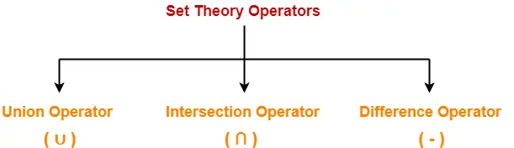
Relational algebra (operations on sets)
To use set theory operators on two relations,
The two relations must be union compatible.
Union-compatible property means- Both relations must have same number of attributes.
The attribute domains (types of values accepted by attributes) of both the relations must be compatible.

Slide 7
Relational algebra (operations on sets)
Union Operator (∪)-
Let R and S be two relations. Then-
R ∪ S is the set of all tuples belonging to either R or S or both.
In R ∪ S, duplicates are automatically removed.
Union operation is both commutative and associative
Example-Consider the following two relations R and S-
ID Name Subject
100 Ankit English
200 Pooja Maths
300 Komal Science
Relation R
ID Name Subject
100 Ankit English
400 Kajol French
Relation S
Then, R ∪ S is-
ID Name Subject
100 Ankit English
200 Pooja Maths
300 Komal Science
400 Kajol French
Relation R ∪ S

Slide 8
Relational algebra (operations on sets)
2. Intersection Operator (∩)-
Let R and S be two relations.
Then-
R ∩ S is the set of all tuples belonging to both R and S.
In R ∩ S, duplicates are automatically removed.
Intersection operation is both commutative and associative.
Example-Consider the following two relations R and S-
ID Name Subject
100 Ankit English
200 Pooja Maths
300 Komal Science
Relation R
ID Name Subject
100 Ankit English
400 Kajol French
Relation S
Then, R ∩ S is-
ID Name Subject
100 Ankit English
Relation R ∩ S

Slide 9
Relational algebra (operations on sets)
3. Difference Operator (-)-
Let R and S be two relations.
Then-
R – S is the set of all tuples belonging to R and not to S.
In R – S, duplicates are automatically removed.
Difference operation is associative but not commutative.
Example-Consider the following two relations R and S-
ID Name Subject
100 Ankit English
200 Pooja Maths
300 Komal Science
Relation R
ID Name Subject
100 Ankit English
400 Kajol French
Relation S
Then, R – S is-
ID | Name | Subject
200 | Pooja | Maths
300 | Komal | Science
Relation R-S

Slide 10
Boolean Algebra
Boolean algebra is a type of algebra that is created by operating the binary system. In 1854, George Boole, an English mathematician, proposed this algebra. This is a variant of Aristotle’s propositional logic that uses the symbols 0 and 1, or True and False. Boolen algebra is concerned with binary variables and logic operations.
Boolean Algebra Operations
There are various operations that are used in Boolean algebra but the basic operations that form the base of Boolean Algebra are,
Negation or NOT Operation
Conjunction or AND Operation
Disjunction or OR Operation
Operator | Symbol | Precedence
NOT | ‘ (or) ⇁ | First
AND | . (or) ∧ | Second
OR | + (or) ∨ | Third

Slide 11
Boolean Algebra
We can easily define these operations using two boolean variables.
Let’s take two boolean variables A and B that can have any of the two values 0 or 1, i.e. they can be either OFF or ON.
Then these operations are explained as,
Negation or NOT Operation:
Using the NOT operation reverse the value of the Boolean variable from 0 to 1 or vice-versa. This can be understood as:
If A = 1, then using NOT operation we have (A)’ = 0
If A = 0, then using the NOT operation we have (A)’ = 1
We also represent the negation operation as ~A, i.e if A = 1, ~A = 0

Slide 12
Boolean Algebra
Conjunction or AND Operation
Using the AND operation satisfies the condition if both the value of the individual variables are true and if any of the value is false then this operation gives the negative result. This can be understood as,
If A = True, B = True, then A . B = True
If A = True, B = False, Or A = false, B = True, then A . B = False
If A = False, B = False, then A . B = False

Slide 13
Boolean Algebra
Disjunction (OR) Operation
Using the OR operation satisfies the condition if any value of the individual variables are true, it only gives a negative result if both the values are false. This can be understood as,
If A = True, B = True, then A + B = True
If A = True, B = False, Or A = false, B = True, then A + B = True
If A = False, B = False, then A + B = False
Boolean Algebra is used to simplify logical circuits that are the backbone of modern technology.

Slide 14
Predicate logic (operations on well-formed formulae (WFF), also called predicate propositions
Well-Formed Formula(WFF) is an expression consisting of variables(capital letters), parentheses, and connective symbols. An expression is basically a combination of operands & operators and here, operands and operators are the connective symbols.
Below are the possible Connective Symbols:
¬ (Negation)
∧ (Conjunction)
∨ (Disjunction)
⇒ (Rightwards Arrow)
⇔ (Left-Right Arrow)

Slide 15
Predicate logic (operations on well-formed formulae (WFF), also called predicate propositions
Statement Formulas
1. Statements that do not contain any connectives are called Atomic or Simple statements, and these statements in themselves are WFFs.
For example,
P, Q, R, etc.

Slide 16
Predicate logic (operations on well-formed formulae (WFF), also called predicate propositions
2. Statements that contain one or more primary statements are called Molecular or Composite statements.
For Example
If P and Q are two simple statements, then some of the Composite statements which follow WFF standards can be formed are:
-> ¬P
-> ¬Q
-> (P ∨ Q)
-> (P ∧ Q)
-> (¬P ∨ Q)
-> ((P ∨ Q) ∧ Q)
-> (P ⇒ Q)
-> (P ⇔ Q)
-> ¬(P ∨ Q)
-> ¬(¬P ∨ ¬Q)

Slide 17
Fuzzy Logic
An approach to variable processing that allows for multiple possible truth values to be processed through the same variable.
Mathematical study of multivalued logic, Fuzzy logic was first proposed by Lotfi Zadeh in a 1965.
A set of rules and functions that can operate on imprecise data sets, but the algorithms still need to be coded by humans.

Slide 18
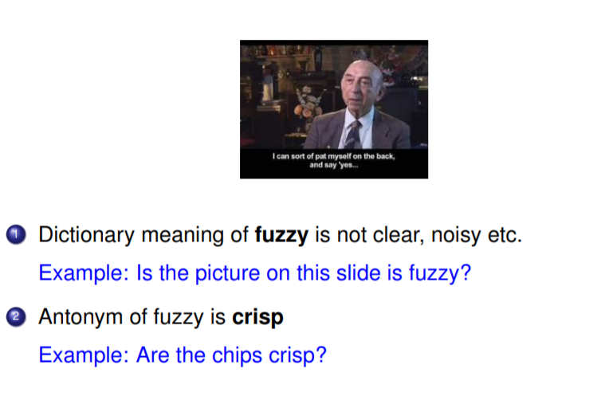
Fuzzy Logic Cont..

Slide 19
Fuzzy Logic MCQ
1. What is the form of Fuzzy logic? (a) Two-valued logic (b) Crisp set logic (c) Many-valued logic (d) Binary set logic
Ans:- c Explanation: With fuzzy logic set membership is defined by certain value. Hence it could have many values to be in the set.
2. Fuzzy logic is proposed by…..
(a) John McCarthy (b) Lotfi Zadeh (c) Allen Turing (d)None of these
Ans:- b Explanation: Mathematical study of multivalued logic, Fuzzy logic was first proposed by Lotfi Zadeh in a 1965.

Slide 20
Fuzzy Logic MCQ Practice
1.Fuzzy logic is usually represented as ___________ a) IF-THEN-ELSE rules
b) IF-THEN rules c) Both IF-THEN-ELSE rules & IF-THEN rules d) None of the mentioned
Ans:-b) IF-THEN rules 2.Japanese were the first to utilize fuzzy logic practically on high-speed trains in Sendai. a) True b) False
Ans:- a) True

Slide 21
CRISP LOGIC
Crisp logic (crisp) is the same as Boolean logic (either 0 or 1). Either a statement is true(1) or it is not(0).
Example:-
Statement:-The agreed to met at 12 o'clock but Ben was not punctual.
Crisp Logic:-
If Ben showed up precisely at 12, he is punctual(Boolean Value 1), otherwise he is too early or too late(Boolean Value 0).

Slide 22
Fuzzy Logic vs CRISP logic-Example

Slide 23
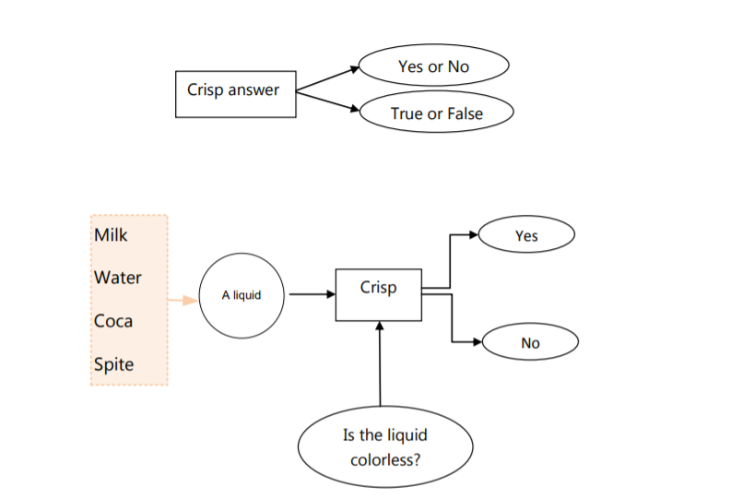
Fuzzy Logic vs Crisp Logic

Slide 24
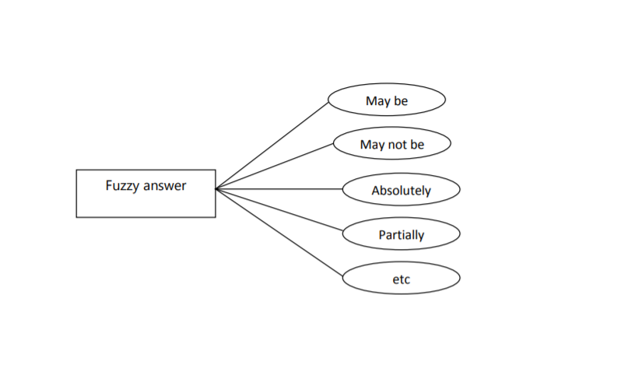

Fuzzy Logic vs Crisp Logic

Slide 25
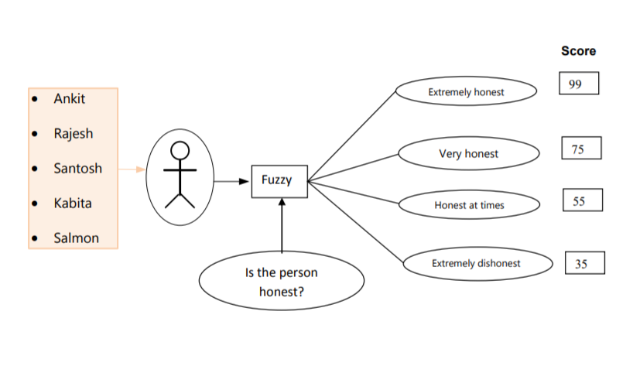
Fuzzy Logic vs Crisp Logic

Slide 26
Fuzzy logic V/S Crisp Logic
Features | Fuzzy Set | Crisp Set
Basic | It is prescribed by vague or ambiguous properties. | It is defined by precise and specific characteristics.
Definition | It is a set of components with different membership degrees in the set. | It is a set of objects that have the same countability and finiteness qualities.
Applications | It is commonly utilized in fuzzy controllers. | It is commonly utilized in digital design.
Membership | It shows incomplete membership. | It shows the complete membership.
Logic | It follows the infinite-valued logic. | It follows the bi-valued logic.
Value | It specifies a number between 0 and 1, which includes both 0 and 1. | It specifies the value as either 0 or 1.
Degree | It defines the degree to which anything is true. | It is also referred to as a classical set.

Slide 27
Pros and Cons of Fuzzy Logic
Pros:-
1.Fuzzy logic is more likely to reflect real-world problems than classical logic.
2.Fuzzy algorithms can produce accurate results with imprecise or inaccurate data.
Cons:-
1.Fuzzy algorithms require broad validation and verification.
2.Fuzzy control systems are dependent on human expertise and knowledge.

Slide 28
CRISP Logic MCQ
1.CRISP Logic is a ……….
(a) infinite-valued logic (b) bi-valued logic
(c) Binary set logic (d) both b and c
Ans:-d
Explanation:-Crisp logic (crisp) is the same as Boolean logic(either 0 or 1). Either a statement is true(1) or it is not(0),so it will be bi valued or binary set logic.

Slide 29
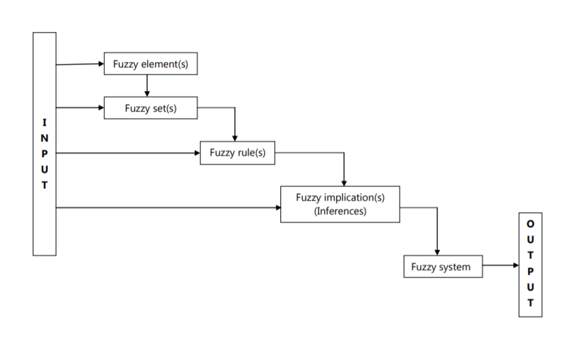
Fuzzy System

Slide 30
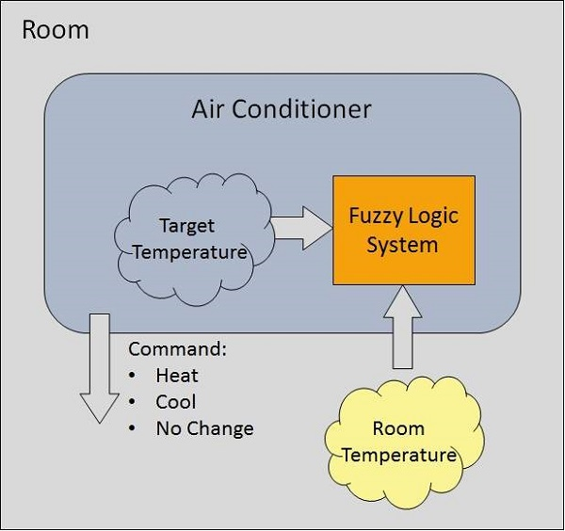
Fuzzy System Example

Slide 31
Fuzzy System MCQ
1. Fuzzy Logic Systems have the …..
Fuzzification Module (b) Knowledge Base
(c) Inference Engine (d) Defuzzification Module (e) All
Ans:- (e) All
Explanation:-It has four main parts as shown −
Fuzzification Module − It transforms the system inputs, which are crisp numbers, into fuzzy sets.
Knowledge Base − It stores IF-THEN rules provided by experts.
Inference Engine − It simulates the human reasoning process by making fuzzy inference on the inputs and IF-THEN rules.
Defuzzification Module − It transforms the fuzzy set obtained by the inference engine into a crisp value.

Slide 32
Fuzzy System MCQ
2.What is the responsibility of fuzzy inference engine?
a. Convert inputs into appropriate fuzzy sets.
b. Form the rules of fuzzy rule base.
c. Evaluate the control rule stored in a fuzzy rule base.
d. Convert fuzzy output in crisp value.
Answer: c
Explanation:- In fuzzy system, main role of fuzzy inference engine is evaluate the control rule stored in a fuzzy rule base.

Slide 33
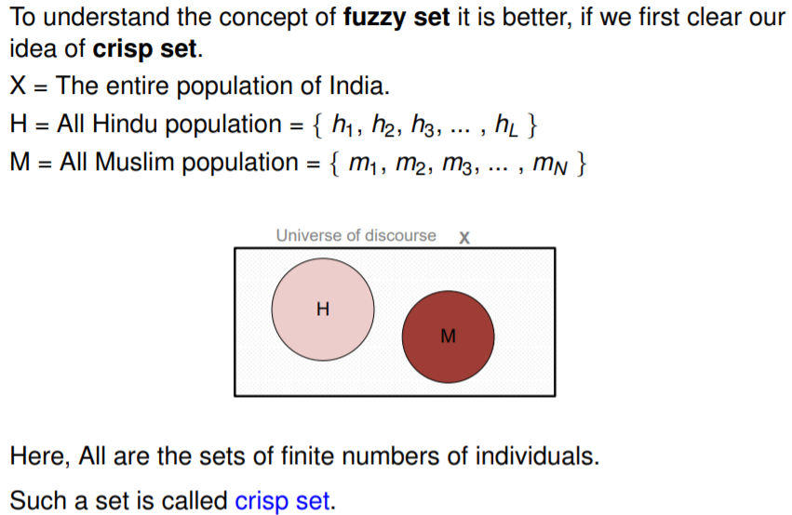
Concept of Fuzzy Set

Slide 34
Concept of Fuzzy Set

Slide 35
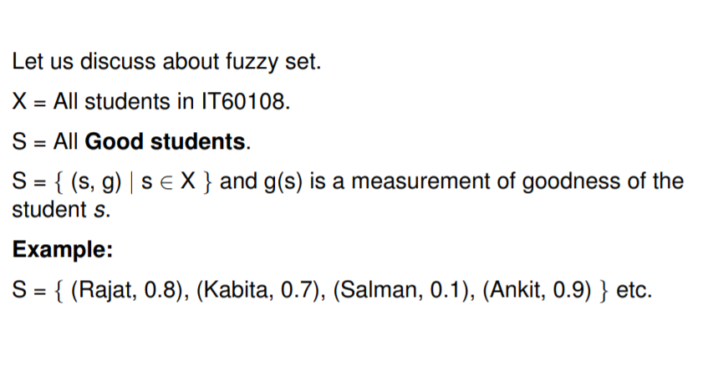
Example

Slide 36
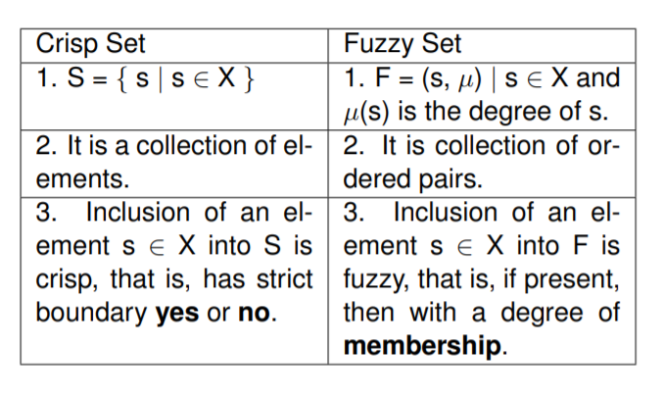
Crisp vs Fuzzy Set

Slide 37
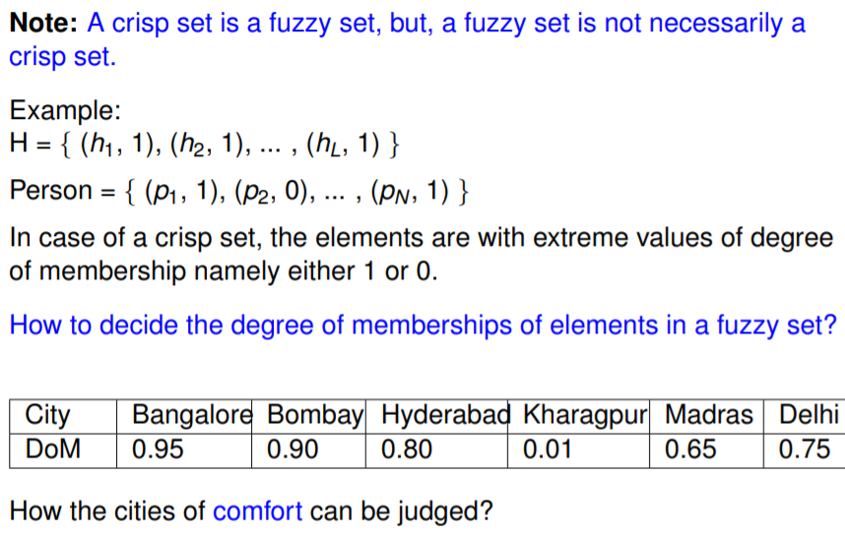
Crisp vs Fuzzy Set

Slide 38
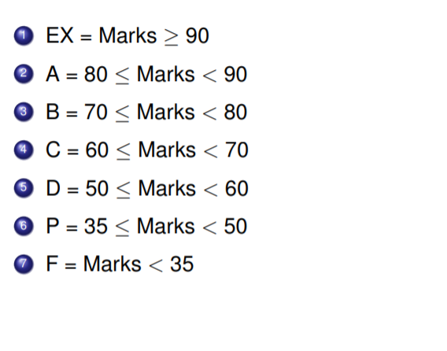
Course Evaluation in Crisp Way

Slide 39
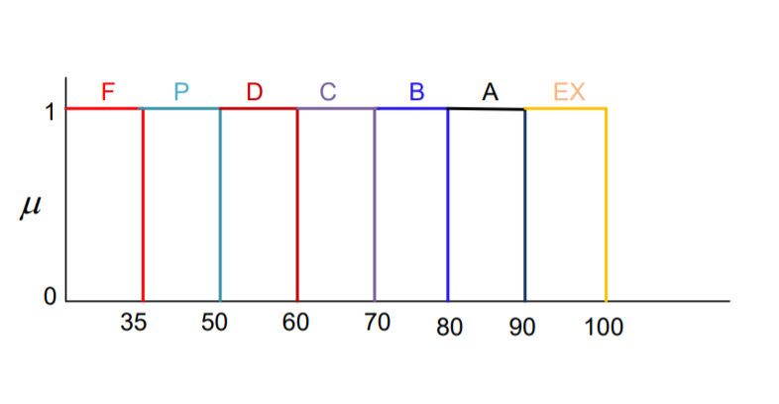
Course Evaluation in Crisp Way

Slide 40
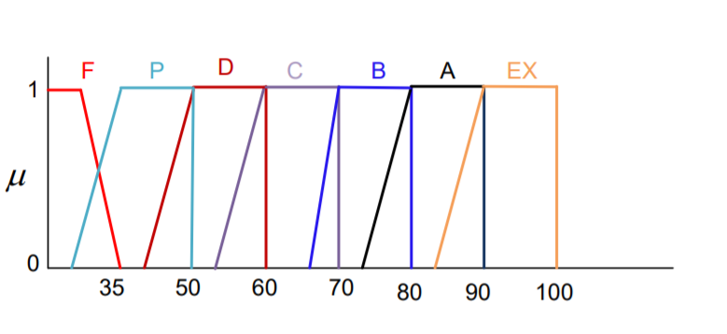
Course Evaluation in Fuzzy Way

Slide 41
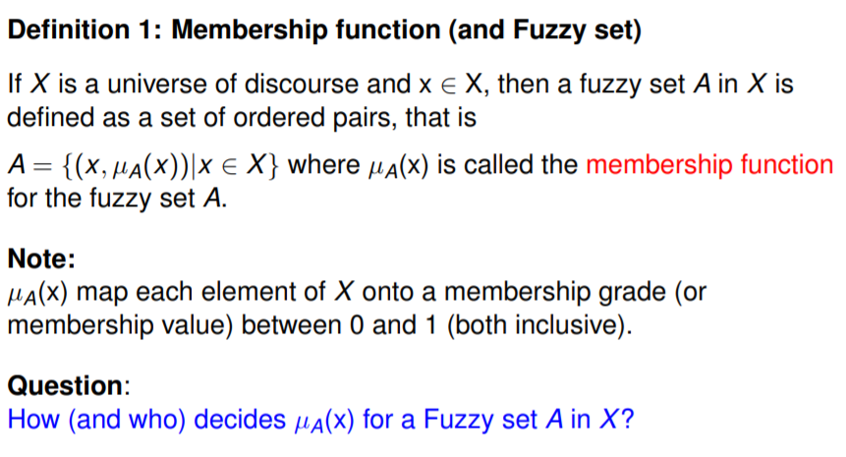
Membership Function

Slide 42
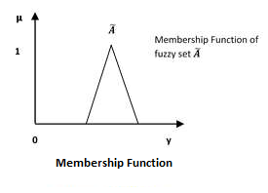
Membership function represents the degree of truth in fuzzy logic and characterize fuzziness (i.e., all the information in fuzzy set), whether the elements in fuzzy sets are discrete or continuous. It is represented by graphical forms.

Slide 43
A fuzzy set Ã in the universe of information U can be defined as a set of ordered pairs and it can be represented mathematically as −
Ã ={(y, μ Ã(y))|y∈U}

Slide 44
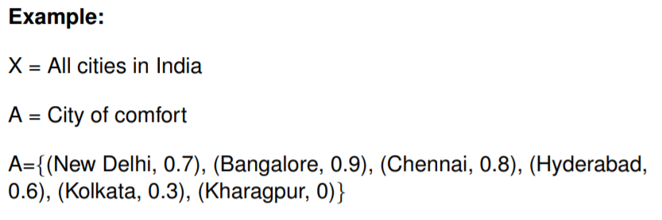
Example

Slide 45
Fuzzy Set MCQ
1.The values of the fuzzy set membership is represented by ___________ a) Discrete Set b) Degree of truth c) Probabilities d) Both Degree of truth & Probabilities
Ans:-d Explanation: Both Probabilities and degree of truth ranges between 0 – 1.
2. Fuzzy Set theory defines fuzzy operators. Choose the fuzzy operators from the following. a) AND b) OR c) NOT d) All of the mentioned
Ans:-d Explanation: The AND, OR, and NOT operators of Boolean logic exist in fuzzy logic, usually defined as the minimum, maximum, and complement;

Slide 46
Fuzzy Set MCQ practice
1.The truth values of Crisp set and fuzzy set is __________ (a) Either 0 or 1, between 0 & 1 (b) Between 0 & 1, either 0 or 1 (c) Between 0 & 1, between 0 & 1 (d) Either 0 or 1, either 0 or 1.
Ans:- (a) Either 0 or 1, between 0 & 1
Explanation:- A fuzzy set is a class of objects with a continuum of grades of membership. Such a set is characterized by a membership function which assigns to each object a grade of membership ranging between zero and one.
2.A set is defined as A= {(a1,0), (a2,0), (a3,1), (a4,0), (a5,1)}.
It is a crisp set. (b)It is a fuzzy set.
(c) Both (a) and (b) true. (d) Both (a) and (b) are not true.
Answer: a, b, c

Slide 47
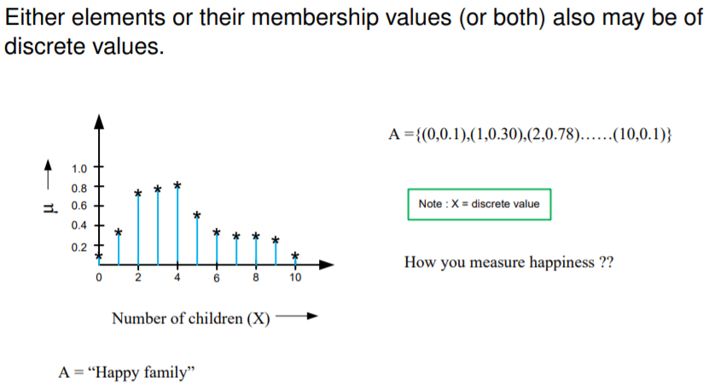
Membership function with discrete Membership values

Slide 48
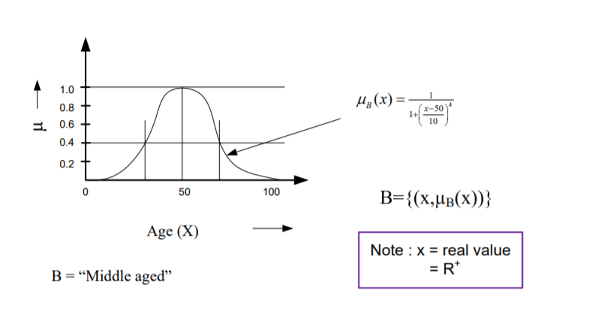
Membership function with Continuous Membership values

Slide 49
Fuzzy Set Membership function MCQ
1. In the membership function graph, x-axis represents?
a. a universe of discourse. b. the degrees of membership in the [0, 1] interval.
c. the degrees of discourse. d. the universe of membership.
Ans:- a
x axis represents the universe of discourse.

Slide 50
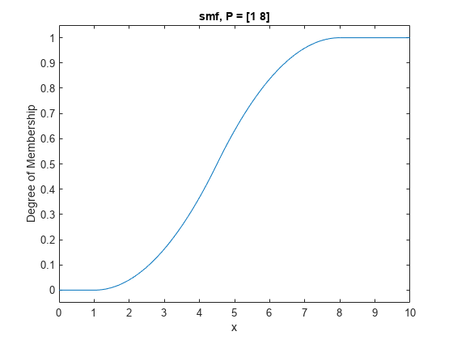
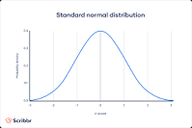
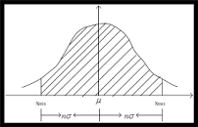
Fuzzy Set Membership function MCQ
1.Which of the following is not a type of membership function?
a) S-shape b) Bell shape
c) Truncated Gaussian d) None of the mentioned
Answer: d
All of the mentioned above are types of Membership functions.

Slide 51
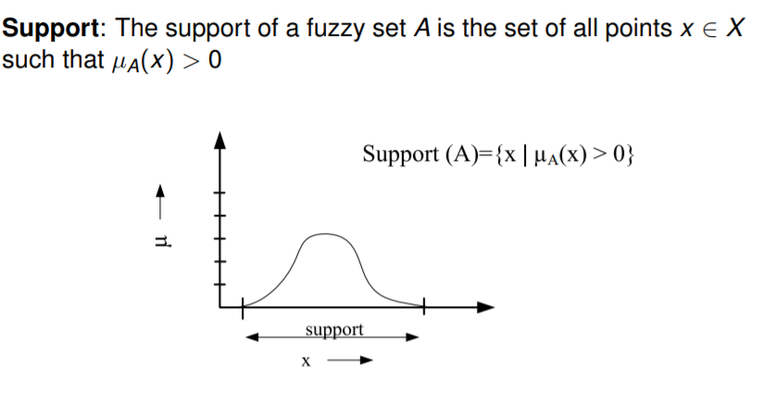
Fuzzy Terminologies: Support

Slide 52
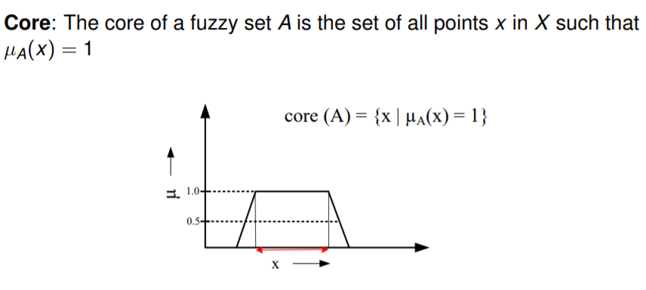
Fuzzy Terminologies: Core

Slide 53
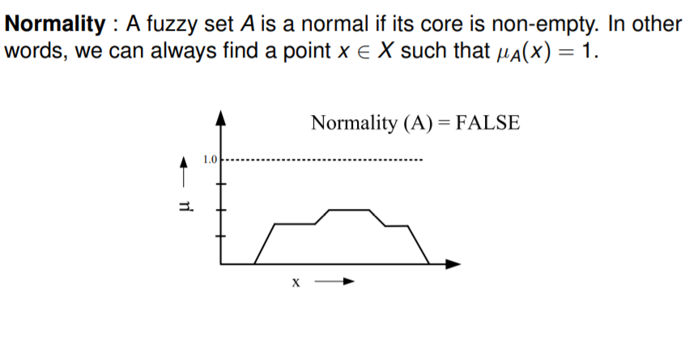
Fuzzy Terminologies: Normality

Slide 54
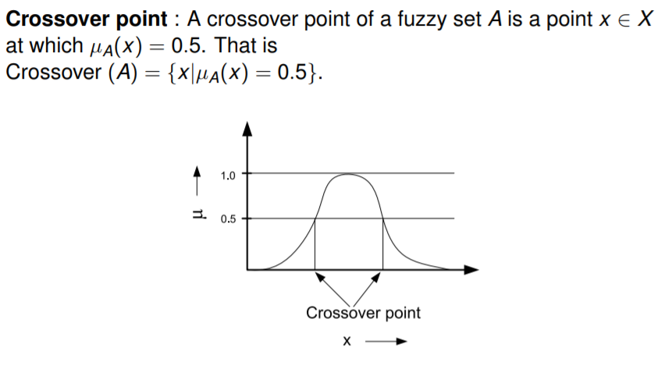
Fuzzy Terminologies: Crossover point

Slide 55
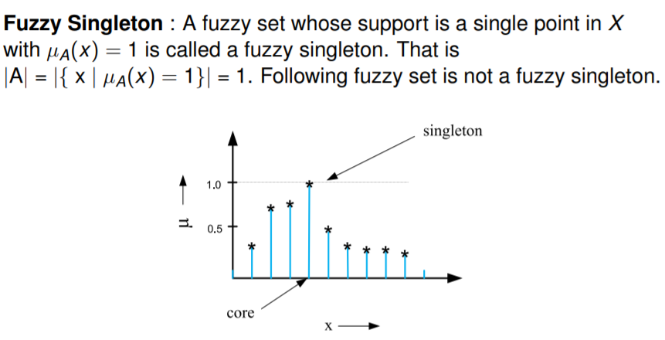
Fuzzy Terminologies: Fuzzy Singleton

Slide 56
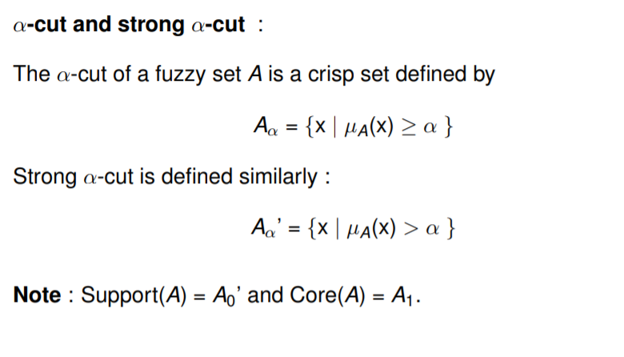
Fuzzy Terminologies: ɑ-cut and strong ɑ-cut

Slide 57
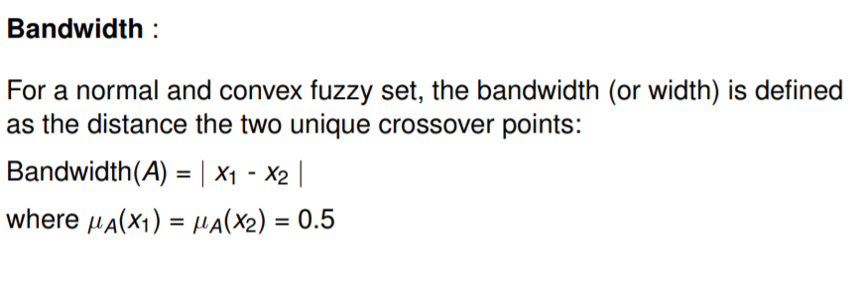
Fuzzy Terminologies: Bandwidth

Slide 58
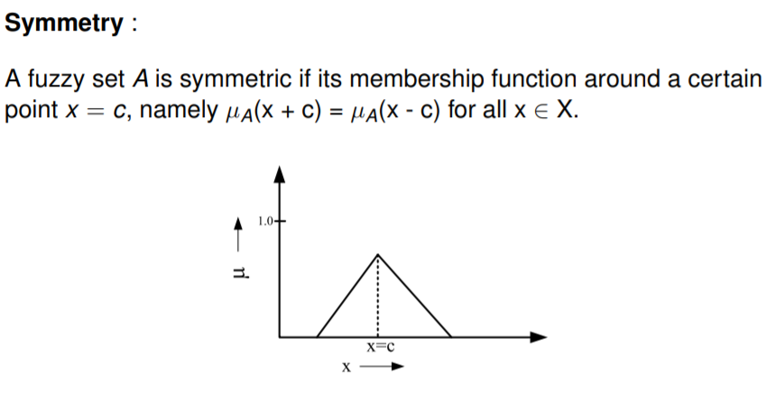
Fuzzy Terminologies: Symmetry

Slide 59
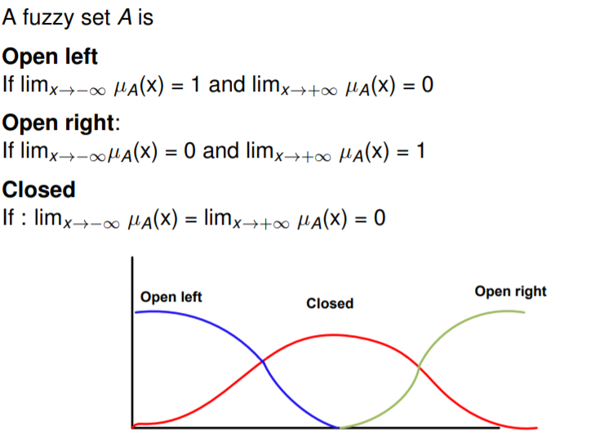
Fuzzy Terminologies: Open and Closed

Slide 60
Fuzzy Terminologies: Convexity
Crisp Set A is convex if (λx₁ + (1 – λ) x₂ ) in A, where λ ∈ [0, 1].
Fuzzy Set A is convex if μ_{A}( λx₁ + (1 – λ) x₂)) ≥ min⁡(μ_{A}(x₁) , μ_{A}(x₂)), where x₁, x₂ ∈ X.
In other words, for any elements x, y and z in a fuzzy set A, the relation x < y < z implies that: μ_{A}(y) ≥ min (μ_{A}(x), μ_{A}(z)). If this condition holds for all points, the fuzzy set is called a convex fuzzy set.
Convex fuzzy sets are strictly increasing and then strictly decreasing
A is convex if all its α-level sets are convex

Slide 61
Fuzzy Terminologies: Height of Fuzzy Set
It is defined as the largest membership value of the elements contained in that set. It may not be 1 always. If the core of the fuzzy set is non-empty, then the height of the fuzzy set is 1.
Example:- A = {(S1,0.4)(S2,0.5)(S3,1)(S4,0.9)(S5,0.8)}
A fuzzy set of SMART students with degree of membership.
So Height of fuzzy set will be 0.9.

Slide 62
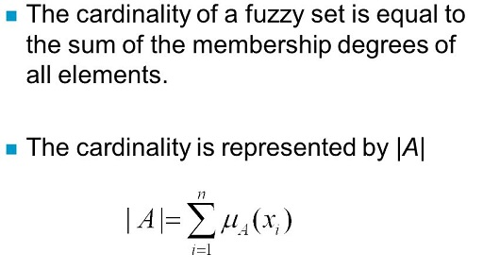
Cardinality

Slide 63
Based on Fuzzy terminologies:-(For Practice)
1.Let A = { (x₁, 0), (x₂, 0.2), (x₃, 0.5), (x₄, 1), (x₅, 1), (x₆, 1), (x₇, 0.5), (x₈, 0.2), (x₉, 0) }, Find support, core, crossover points, alpha cut and strong alpha cut for α = 0.2, boundary, bandwidth, normality, scalar and relative cardinality of the given fuzzy set.

Slide 64
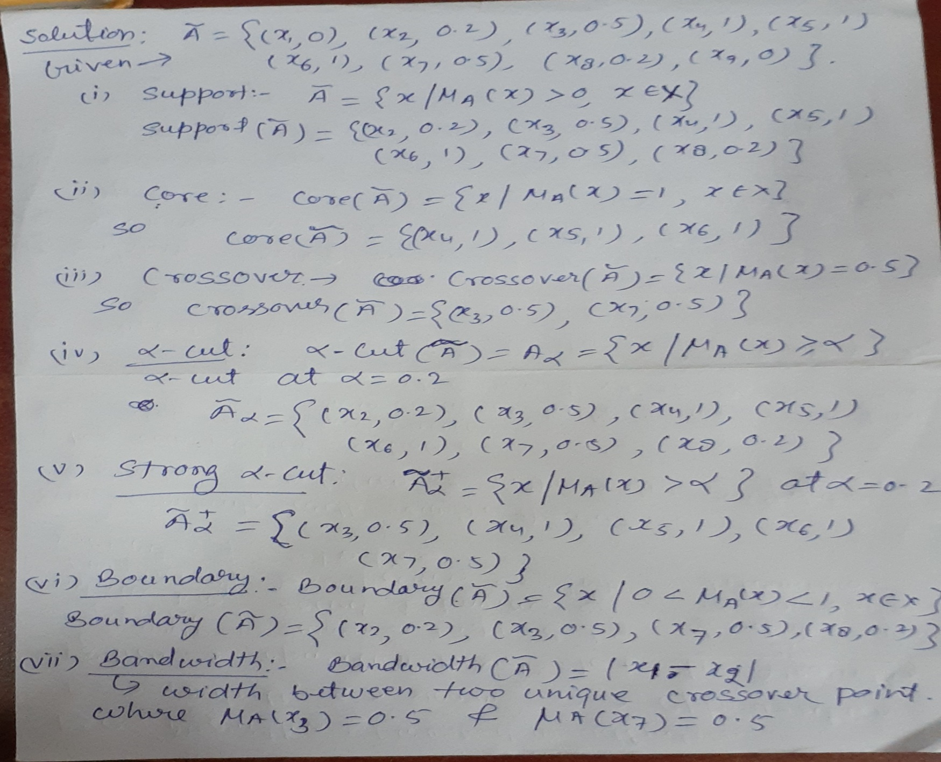
Solution

Slide 65
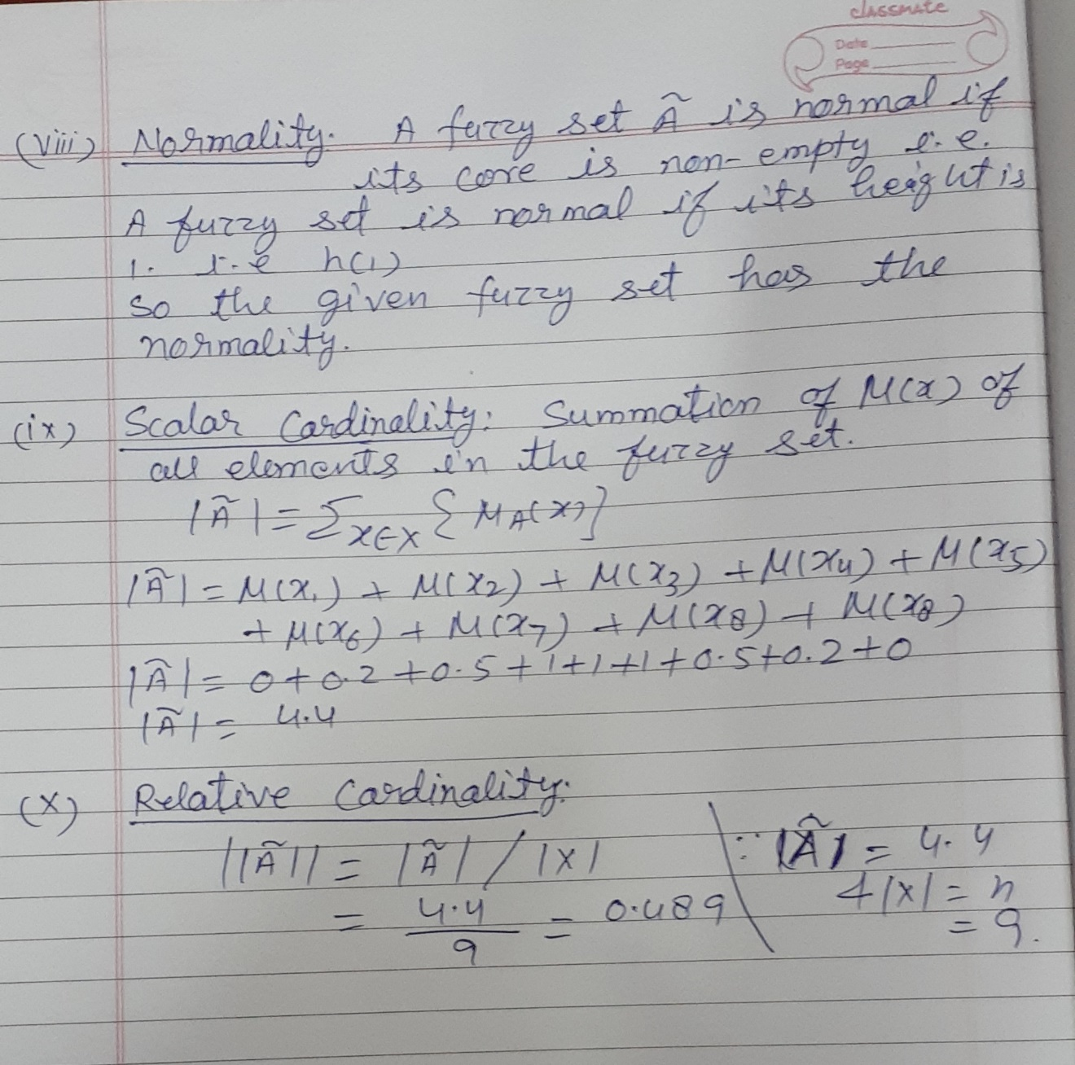

Slide 66
2.For the fuzzy set A = { (x₁, 0), (x₂, 0.3), (x₃, 0.4), (x₄, 0.5), (x₅, 0.8), (x₆, 1), (x₇, 1), (x₈, 1), (x₉, 1), (x₁₀, 0.7), (x₁₁ , 0.5) , (x₁₂, 0.1), (x₁₃, 0) }, find following.
Support ,Core, Crossover points
Alpha cut for α = 0.3,Strong Alpha cut for α = 0.4
Boundary, Normality

Slide 67
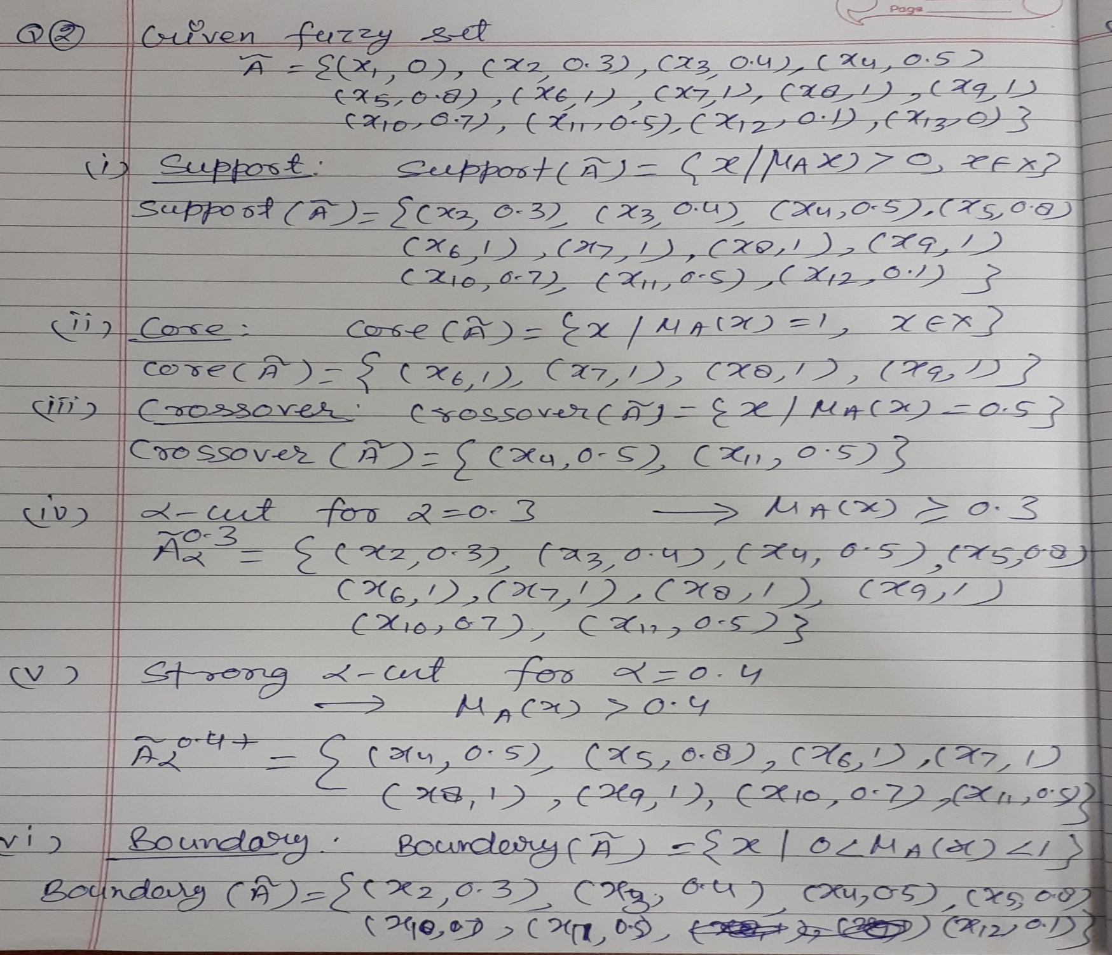
Solution

Slide 68
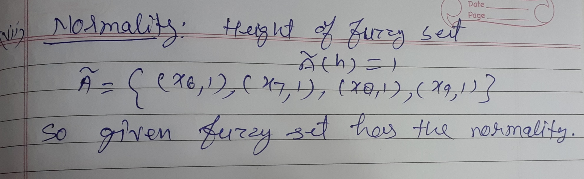

Slide 69
Fuzzy Terminologies based MCQ questions
1.A __________ point of a fuzzy set A is a point x ∈ X at which µA(x) = 0.5
Core (b) Support (C ) Cross-over (d)α – cut
Ans:-C
Explanation:-A crossover point of a fuzzy set A is a point x ∈ X at which iA(x) = 0.5. That is Crossover (A) = {x|iA(x) = 0.5}.
2.Fuzzy singleton is a …..
set of all points x ∈ X such that μ_{A}(x) > 0
(b) set of all points x ∈ X such that μ_{A}(x) = 1
(c) elements x of the universe such that 0 < μ_{A}(x) < 1
(d) core is a single point in X with μ_{A}(x) = 1.
Ans:- (d) core is a single point in X with μ_{A}(x) = 1.
Explaination:- A fuzzy set whose core is a single point in X with μ_{A}(x) = 1, is called a fuzzy singleton. In other words, if the fuzzy set is having only one element with a membership value of 1, then it is called a fuzzy singleton.
|A| = { μ_{A}(x) = 1 }

Slide 70
Fuzzy Terminologies based MCQ questions
3.The set of all points x in X in a fuzzy set A is defined as a “core”, if
(a) μA(X) = 0 (b) μA(X) > 1 (c) μA(X) = 1 (d) μA(X) < 1
Answer: (c) μA(X) = 1
Explanation:- The core of a fuzzy set A is the set of all points x ∈ X such that μ_{A}(x) = 1 Core( A ) = { x | μ_{A}(x) = 1, x ∈ X }
4. A fuzzy set A is closed if:
a. If lim x → −∞ μA(x) = 1and lim x → +∞ μA(x) = 0
b. If lim x → −∞ μA(x) = lim x → +∞ μA(x) = 0
c. If lim x → −∞ μA(x) = 0 and lim x → +∞ μA(x) = 1
d. If lim x → −∞ μA(x) = lim x → +∞ μA(x) = 1
Answer: b
Detailed Solution: Option (b) is the condition for the closeness of a fuzzy set.

Slide 71
Properties of Fuzzy Sets
1.Involution:-Involution states that the complement of complement is set itself.( A‘ )’ = A
2.Commutativity:-Operations are called commutative if the order of operands does not alter the result. Fuzzy sets are commutative under union and intersection operations.
(i) A ∪ B = B ∪ A
(ii) A ∩ B = B ∩ A

Slide 72
Properties of Fuzzy Sets
Associativity
Fuzzy sets are associative under union and intersection operations.
A ∪ ( B ∪ C ) = ( A ∪ B ) ∪ C
A ∩ ( B ∩ C ) = ( A ∩ B ) ∩ C
Distributive
A ∪ ( B ∩ C ) = ( A ∪ B ) ∩ ( A ∪ C )
A ∩ ( B ∪ C ) = ( A ∩ B ) ∪ ( A ∩ C )

Slide 73
Properties of Fuzzy Sets
Absorption
Absorption produces identical sets after stated union and intersection operations.
A ∪ ( A ∩ B) = A
A ∩ ( A ∪ B ) = A
Idempotency / Tautology
Idempotency does not alter the element or the membership value of elements in the set
A ∪ A = A
A ∩ A = A

Slide 74
Properties of Fuzzy Sets
Identity
A ∪ ϕ = A , A ∩ ϕ = ϕ , A ∪ X = X , A ∩ X = A
Transitivity
If A ⊆ B and B ⊆ C then A ⊆ C
De Morgan’s Law:- De Morgan’s Laws can be stated as,
(i) The complement of a union is the intersection of the complement of individual sets. ( A ∪ B )’ = A‘ ∩ B‘
(ii) The complement of an intersection is the union of the complement of individual sets.( A ∩ B )’ = A’ ∪ B‘

Slide 75
MCQ based on Fuzzy set properties
1.If A, B and C are any three sets, then A – (B ∪ C) is equal to
(A – B) ∪ (A – C) (b) (A – B) ∪ C
(c) (A – B) ∩ C (d) (A – B) ∩ (A – C)
Answer: d
Explanation: A − (B ∪ C) = A ∩ (B ∪ C) ′ = A ∩ (B′∩ C′) = (A ∩ B′) ∩ (A ∩ C′) = (A − B) ∩ (A − C).
2. A ⋃ (A ⋂ B) = A represents
(a) Law of excluded middle (b) Law of absorption
(c) Demorgans law (d) Law of contradiction
Ans:- (b) Law of absorption
Explanation:-Absorption produces identical sets after stated union and intersection operations.
A ∪ ( A ∩ B) = A
A ∩ ( A ∪ B ) = A

Slide 76
Linguistic Variable
Also known as Fuzzy Variable or Atomic Term that is is primarily associated with quantifying and reasoning out imprecise or vague terms that appear in natural languages.
i.e. A variable whose values are words or sentences in a natural or artificial language.
Each linguistic variable consists of the following elements
A name, which should capture the meaning of the base variable involved like temperature.
A base variable with its range of values (a closed interval of real numbers) like [0,100].
A set of linguistic terms that refer to values of the base variable
like cold, warm etc.
A semantic rule, which assigns to each linguistic term its meaning—an appropriate fuzzy number defined on the range of the base variable

Slide 77
Linguistic Variables
We can categorize linguistic variables as follow:
Quantification terms: all, most, many, about one-fourth, some
Usuality terms: always, sometimes, seldom, never
Likelihood terms: certain, likely, possible, certainly not
An example
“temperature,” which captures the meaning of the associated base variable—a variable that expresses the room temperature T (in degree) by real numbers in the interval [0,60], Linguistic values (states) of the linguistic variable are “Cold,” “warm”, “high” and “extreme.” Each of these linguistic terms is assigned one of the fuzzy values.

Slide 78
MCQ
1.The room temperature is hot. Here, the hot (use of linguistic variable is used) can be represented by
a. Fuzzy set b. Crisp set
c. Fuzzy & Crisp set d. None of the mentioned
Answer: a
Fuzzy logic deals with linguistic variables.
2. Fuzzy logic uses
(a) Global variables (b) Linguistic variables
(c) Local variables (d) Approximate variables
Ans:- (b) Linguistic variables

Slide 79
Linguistic Hedges
It is an operation that modifies the meaning of a fuzzy set. In other words, hedges are the operators which modify the shapes of fuzzy sets by using adverbs such as more, high, less, and slightly.
For example, how high the temperature is? Depending upon we can have answers such as very high or slightly high etc. These are examples of hedges applied to the fuzzy set of the temperature.
Types of hedges:
Intensify a fuzzy set (very, extremely)
Dilute a fuzzy set (somewhat, sort of)
Express probabilities (probably, not likely)
Approximate a scalar or single number (exactly)
Express vague quantities (most, seldom)

Slide 80
Linguistic Hedges
Example:-
A = cold climate with μ_{A}(x) as the MF
B = Hot climate with μ_{B}(x) as the MF.
Not cold climate: A‘ =1 – μ_{A}(x)
Not hot climate: B‘ =1 – μ_{B}(x)
Extreme climate: A ∪ B = max⁡( μ_{A}(x), μ_{B}(x) )
Pleasant climate: A ∩ B = min⁡( μ_{A}(x), μ_{B}(x) )

Slide 81
MCQ
1.There are some operators that are more linguistic in nature and commonly known as …… that can be applied to fuzzy set theory.
(A). Lingual Variable (B). Hedges
(C). Fuzz Variable (D). None of these
Answer: (B). Hedges
Explanation:-A linguistic hedge is an operation that modifies the meaning of a fuzzy set, which can be understood as terms that modify the shapes of fuzzy sets by using adverbs such as very, quite, more, less and slightly.

Slide 82
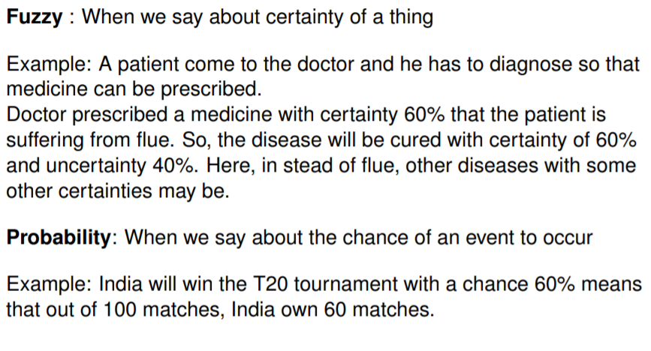
Fuzzy vs Probability

Slide 83

Topic
Evaluation of an Learning Algorithm

Slide 84
Experimental Evaluation of Learning Algorithm
Evaluating the performance of learning system is important because:
-Learning systems are usually designed to predict the class of “future” unlabelled data points.
Typical choices for Performance evaluation:
-Error
-Accuracy
-Precision
-Recall

Slide 85
Evaluating Predictions
For Regression Problem performance measure is Mean Absolute Error and Root mean Square Error.
Suppose we want to make a prediction of a value for a target feature on example x:
-y is the observed value of target feature on example x.
-y’ is the predicted value of target feature on example x.
- How is the error measured?

Slide 86
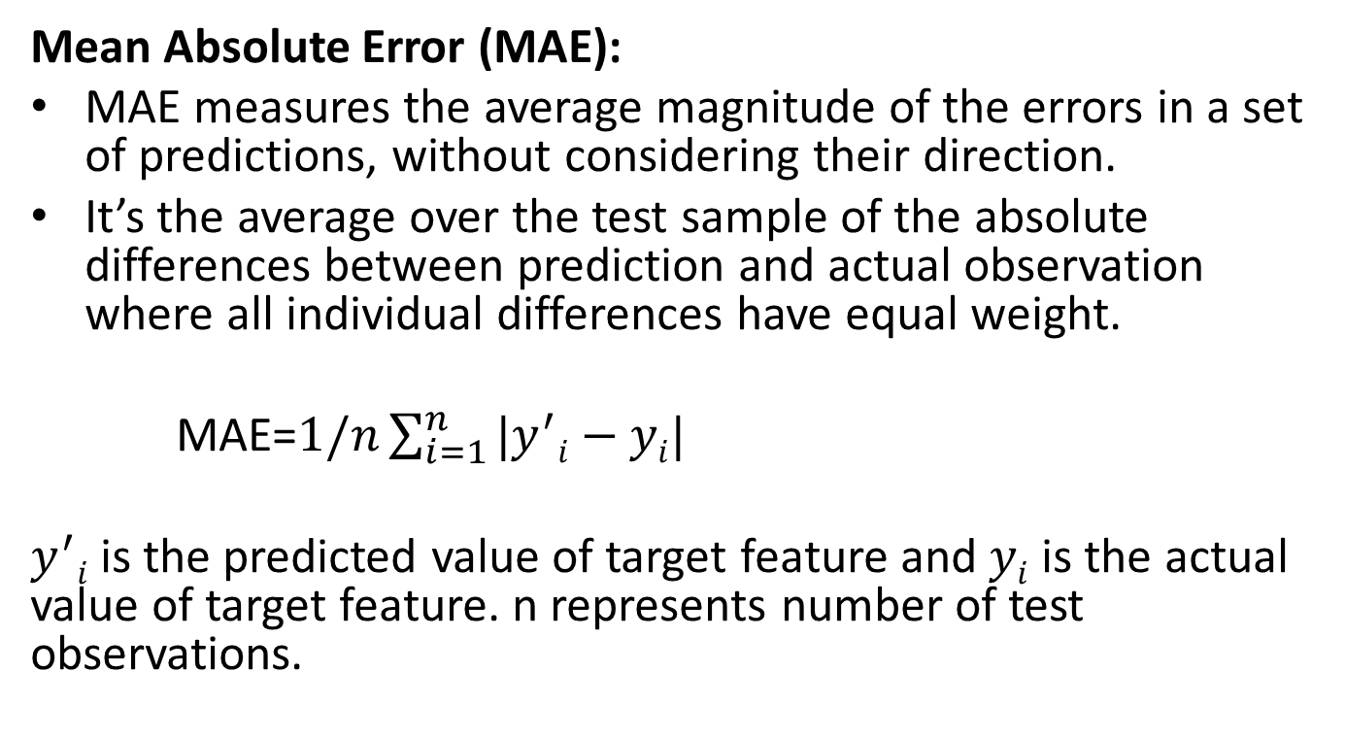
Error
Mean Absolute Error (MAE):
MAE measures the average magnitude of the errors in a set of predictions, without considering their direction.
It’s the average over the test sample of the absolute differences between prediction and actual observation where all individual differences have equal weight.
MAE=$1/n\sum_{i=1}^{n}{|y^{′}i−yi|}$
$y^{′}i$ is the predicted value of target feature and $yi$ is the actual value of target feature. n represents number of test observations.

Slide 87
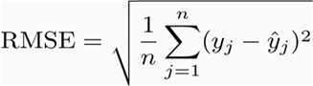
Error
Root mean squared error (RMSE):
RMSE is a quadratic scoring rule that also measures the average magnitude of the error. It’s the square root of the average of squared differences between prediction and actual observation.
Taking the square root of the average squared errors has some interesting implications for RMSE. Since the errors are squared before they are averaged, the RMSE gives a relatively high weight to large errors. This means the RMSE should be more useful when large errors are particularly undesirable.

Slide 88
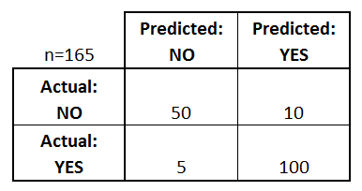
Confusion Matrix
A confusion matrix is a table that is often used to describe the performance of a classification model (or "classifier") on a set of test data for which the true values are known.
Let's start with an example confusion matrix for a binary classifier

Slide 89
Confusion Matrix
What can we learn from this matrix?
1. There are two possible predicted classes: "yes" and "no". If we were predicting the presence of a disease, for example, "yes" would mean they have the disease, and "no" would mean they don't have the disease.
2. The classifier made a total of 165 predictions (e.g., 165 patients were being tested for the presence of that disease).
3. Out of those 165 cases, the classifier predicted "yes" 110 times, and "no" 55 times.
4. In reality, 105 patients in the sample have the disease, and 60 patients do not.

Slide 90
Confusion Matrix
true positives (TP): These are cases in which we predicted yes (they have the disease), and they do have the disease.
true negatives (TN): We predicted no, and they don't have the disease.
false positives (FP): We predicted yes, but they don't actually have the disease. (Also known as a "Type I error.")
false negatives (FN): We predicted no, but they actually do have the disease. (Also known as a "Type II error.")

Slide 91
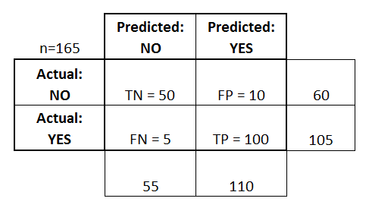
Example
Accuracy or Classification rate: Overall, how often is the classifier correct?
Ans. (TP+TN)/total = (100+50)/165 = 0.91

Slide 92
Example
Misclassification Rate: Overall, how often is it wrong?
Ans. (FP+FN)/total = (10+5)/165 = 0.09
also known as "Error Rate“.
True Positive Rate: When it's actually yes, how often does it predict yes?
Ans. TP/TP+FN(actual yes) = 100/105 = 0.95
also known as "Sensitivity" or "Recall“.

Slide 93
Example
False Positive Rate: When it's actually no, how often does it predict yes?
FP/actual no = 10/60 = 0.17
True Negative Rate: When it's actually no, how often does it predict no?
TN/actual no = 50/60 = 0.83
equivalent to 1 minus False Positive Rate
also known as "Specificity“.

Slide 94
Example
Precision: When it predicts yes, how often is it correct?
Ans. TP/TP+FP(predicted yes) = 100/110 = 0.91.
Prevalence: How often does the yes condition actually occur in our sample?
Ans. actual yes/total = 105/165 = 0.64

Slide 95
High recall, low precision: This means that most of the positive examples are correctly recognized (low FN) but there are a lot of false positives.
Low recall, high precision: This shows that we miss a lot of positive examples (high FN) but those we predict as positive are indeed positive (low FP).

Slide 96
Problem
Q. Assume the following:
A database contains 80 records on a particular topic . A search was conducted on that topic and 60 records were retrieved. Of the 60 records retrieved, 45 were relevant.
Calculate the precision and recall scores for the search.

Slide 97
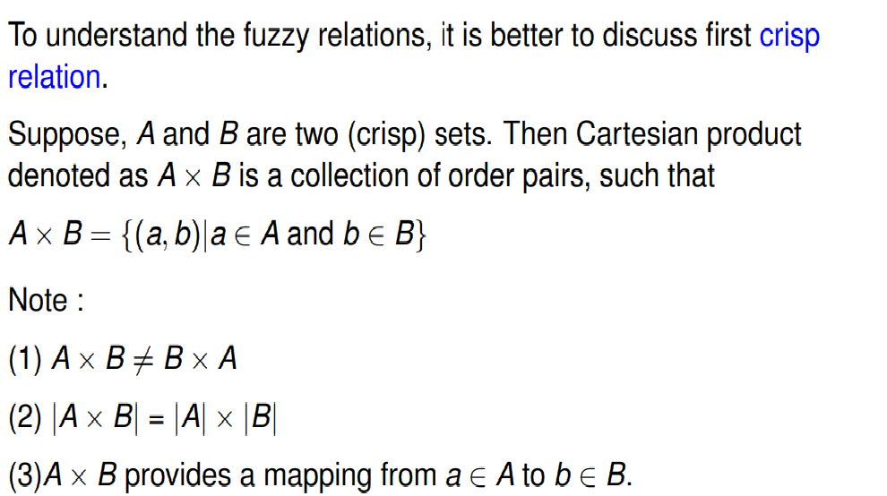
Crisp Relation

Slide 98
Crisp Relation
Crisp relation is a set of order pairs (a, b) from Cartesian product A × B such that a ∈ A and b ∈ B. Relations basically represent the mapping of the sets A & B. It defines the interaction or association of variables.
The strength of the relationship between ordered pairs of elements in each universe is measured by the characteristic function denoted by χ. Where a value of unity is associated with a complete relationship and a value of zero is associated with no relationship, i.e.
χR(a,b)={1,if(a,b)∈(A×B) otherwise 0,if(a,b)∉(A×B)
Useful in logic, pattern recognition, control system, classification etc.Crisp

Slide 99
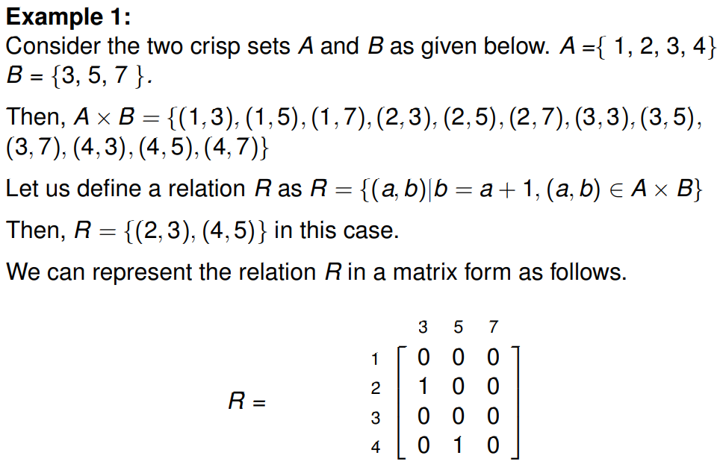
Crisp Relation

Slide 100
MCQ
1.Collection of ordered pair elements (No membership function Value) is known as…
(a)Crisp Set (b)Fuzzy Set (c ) both a & B (d) Crisp Relation
Ans:-(d) Crisp Relation
Explanation:-Crisp relation is a set of order pairs (a, b) from Cartesian product A × B such that a ∈ A and b ∈ B.
2. “A Crisp relation will be always subset of the Cartesian product of two set A and B.” It is….
False (b) True
Ans:-(b) True

Slide 101
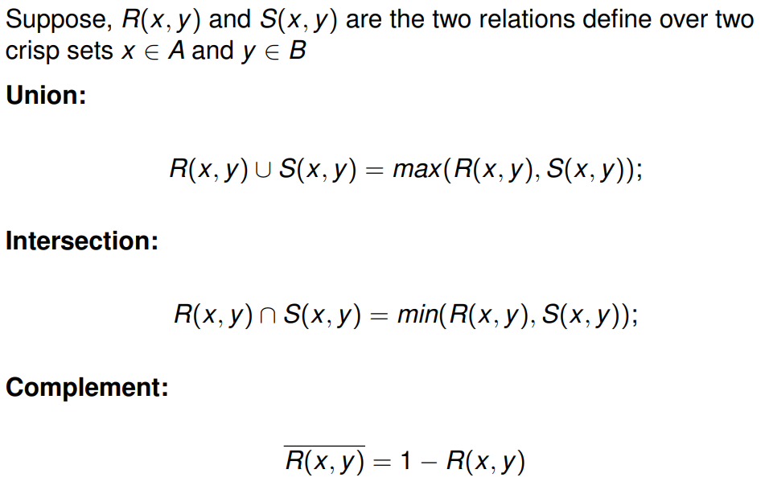
Operations on Crisp Relation

Slide 102
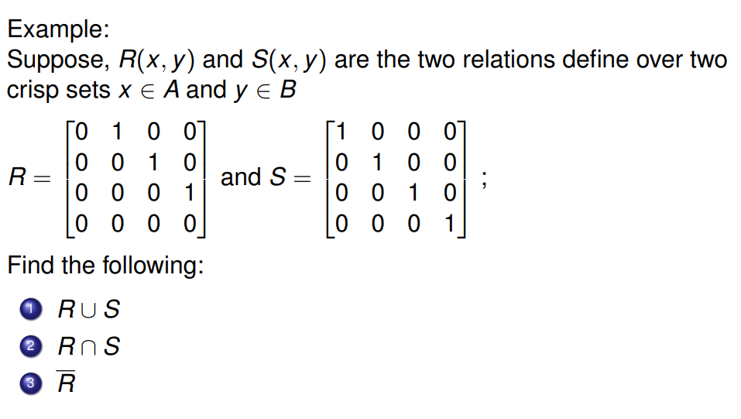
Example

Slide 103

Example (Contd..)
R(x,y) U S(x,y) = 1 1 0 0
0 1 1 0
0 0 1 1
0 0 0 1
R(x,y) S S(x,y)= 0 0 0 0
0 0 0 0
0 0 0 0
0 0 0 0
R = 1 0 1 1
1 1 0 1
1 1 1 0
1 1 1 1

Slide 104
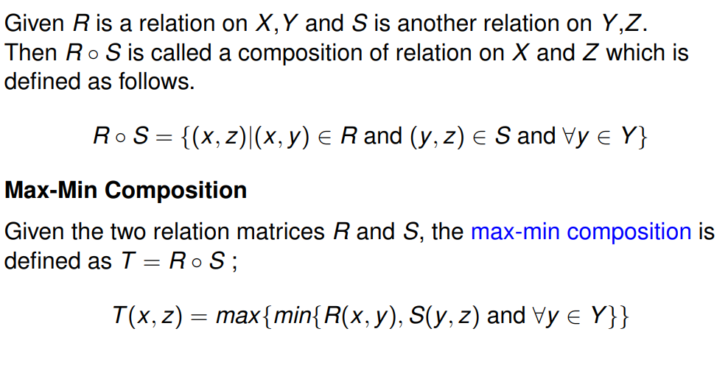
Composition of two crisp relations

Slide 105
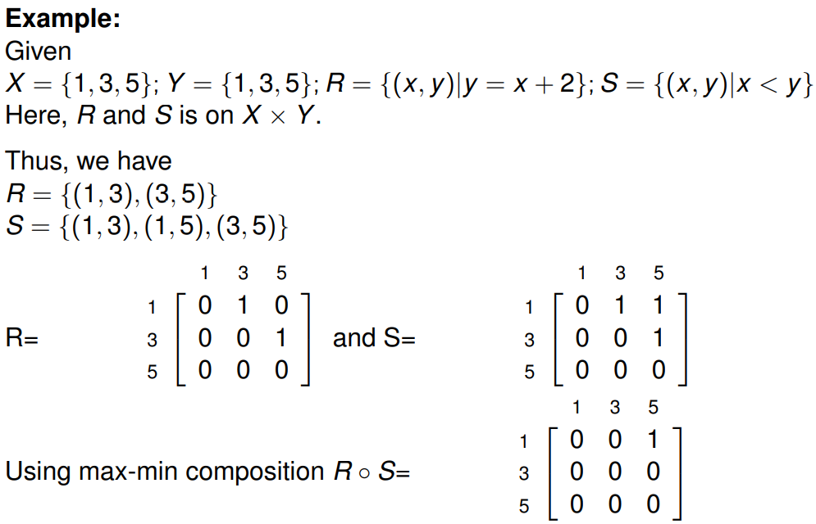
Example

Slide 106
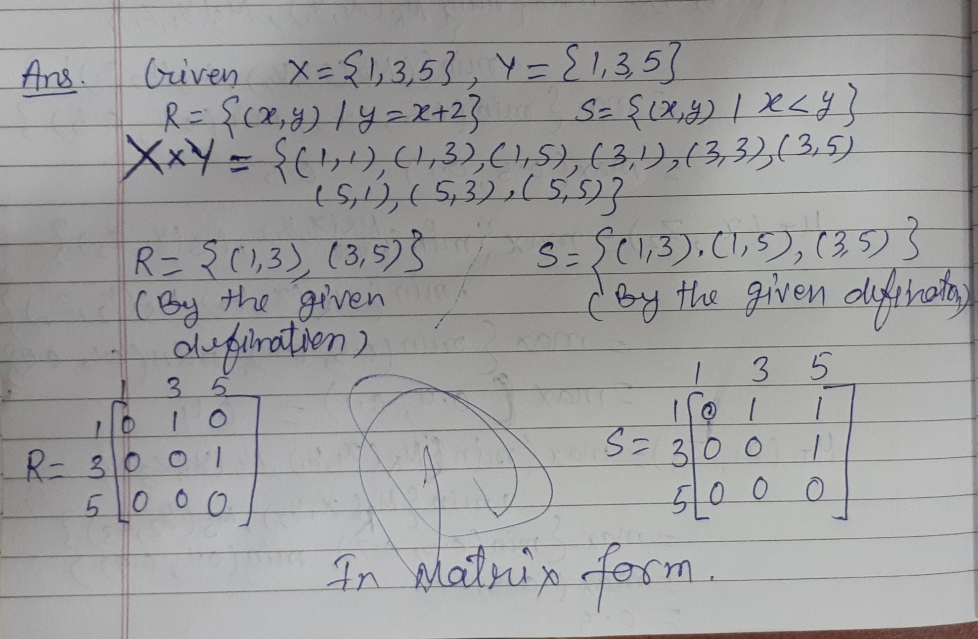

Slide 107
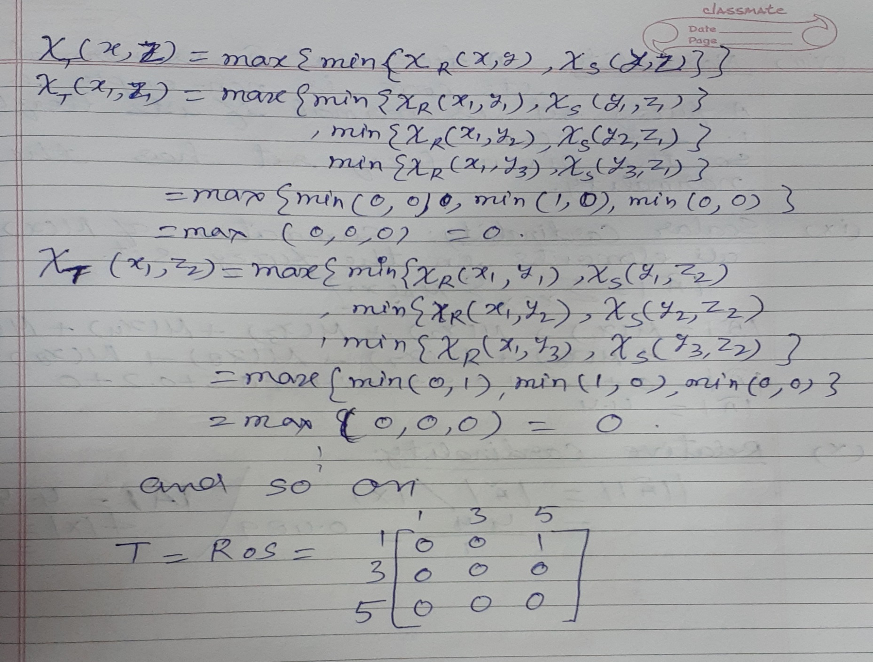

Slide 108
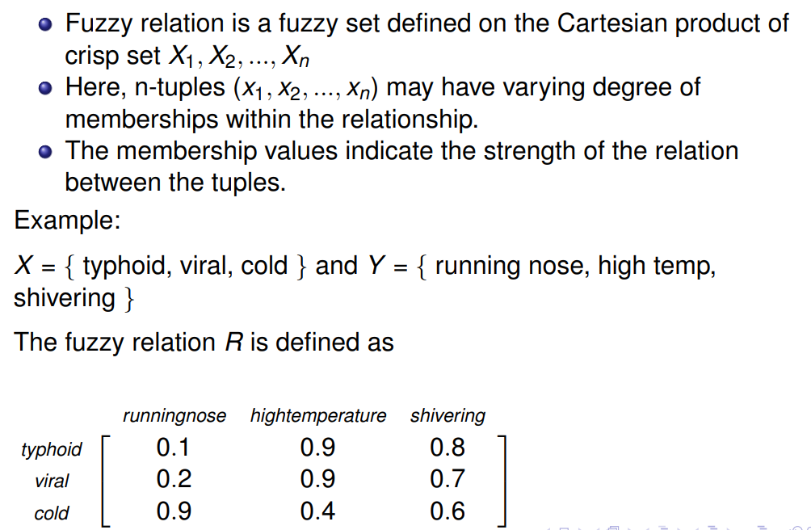
Fuzzy Relations

Slide 109

Fuzzy Cartesian Product

Slide 110

Operations on Fuzzy Relations

Slide 111

Example Of Operations On Fuzzy Relation: Union Operation

Slide 112

Union Operation Contd…

Slide 113

Intersection Operation
min

Slide 114

Intersection Operation Conti…
min

Slide 115

Complement Operation

Slide 116

Example

Slide 117

Solution

Slide 118


Slide 119

Fuzzy Relation: An Example

Slide 120

Fuzzy Relation: An Example (contd..)

Slide 121

Problem

Slide 122
MCQ
1.Given U = {1,2,3,4,5,6,7},A = {(3, 0.7), (5, 1), (6, 0.8)},then A complement is
(a) {(4, 0.7), (2,1), (1,0.8)}
(b) {(4, 0.3.): (5, 0), (6. 0.2) }
(c) {(l, 1), (2, 1), (3, 0.3), (4, 1), (6,0.2), (7, 1)}
(d) {(3, 0.3), (6.0.2)}
Ans:-(c) {(l, 1), (2, 1), (3, 0.3), (4, 1), (6,0.2), (7, 1)}
Explanation:-Complement: Fuzzy complement is identical to crisp complement operation. The membership value of every element in the fuzzy set is complemented with respect to 1, i.e. it is subtracted from 1.

Slide 123
MCQ
2.If A and B are two fuzzy sets with membership functions:
μa(χ) ={0.2,0.5.,0.6,0.1,0.9}, μb (χ)= {0.1,0.5,0.2,0.7,0.8},then the value of μa ∩ μb will be
(a) {0.2,0.5,0.6,0.7,0.9} (b) {0.2, 0.5,0.2, 0.1,0.8}
(c) {0.1, 0.5, 0.6, 0.1,0.8} (d) {0.1, 0.5, 0.2, 0.1,0.8}
Ans:-(d) {0.1, 0.5, 0.2, 0.1,0.8}
Explanation:-Use intersection operation.
Intersection: μA B(x) = min (μA(x), μB(x))

Slide 124
Fuzzy Propositions
Two-valued logic vs. Multi-valued logic
The basic assumption upon which crisp logic is based - that every proposition is either TRUE or FALSE.
The classical two-valued logic can be extended to multi-valued logic.
As an example, three valued logic to denote true(1), false(0) and indeterminacy ( 1 2 ).

Slide 125
Propositions
A proposition is a declarative statement which is either true or false. It is a technique of knowledge representation in logical and mathematical form.
Types of propositions: The syntax of propositional logic defines the allowable sentences for the knowledge representation. There are two types of Propositions:
Atomic Propositions:-An atomic proposition is a statement or assertion that must be true or false.
Examples of atomic propositions are: “5 is a prime”
Compound propositions:- A compound proposition which consists of two propositions joined by the logical connective phrase like and, or etc.
Example:- If x is an integer, then x² is a +ve integer.

Slide 126
Propositional Logics:-Basic facts
Also called Boolean logic as it works on 0 and 1.
Use symbolic variables to represent the logic, and we can use any symbol for a representing a proposition, such A, B, C, P, Q, R, etc.
It can be either true or false, but it cannot be both.
It consists of an object, relations or function, and logical connectives.
These connectives are also called logical operators, Connectives can be said as a logical operator which connects two sentences.
A proposition formula which is always true is called tautology, and it is also called a valid sentence.
A proposition formula which is always false is called Contradiction.
Statements which are questions, commands, or opinions are not propositions such as "Where is Rohini", "How are you", "What is your name", are not propositions.

Slide 127
Logical Connectives
Name of Connective | Connective Word | Symbol
Negation | Not | ⌉ or ∼ or ' or -
Conjunction | And | ∧
Disjunction | Or | ∨
Conditional | If-then | →
Bi-conditional | If and only if | ↔

Slide 128
Laws of Propositional logic
De Morgan’s laws: | ¬( p ∨ q ) ≡ ¬p ∧ ¬q | ¬( p ∧ q ) ≡ ¬p ∨ ¬q
Idempotent laws: | p ∨ p ≡ p | p ∧ p ≡ p
Associative laws: | ( p ∨ q ) ∨ r ≡ p ∨ ( q ∨ r ) | ( p ∧ q ) ∧ r ≡ p ∧ ( q ∧ r )
Commutative laws: | p ∨ q ≡ q ∨ p | p ∧ q ≡ q ∧ p
Distributive laws: | p ∨ ( q ∧ r ) ≡ ( p ∨ q ) ∧ ( p ∨ r ) | p ∧ ( q ∨ r ) ≡ ( p ∧ q ) ∨ ( p ∧ r )
Identity laws: | p ∨ F ≡ p | p ∧ T ≡ p
Domination laws: | p ∧ F ≡ F | p ∨ T ≡ T
Double negation law: | ¬ ¬p ≡ p
Complement laws: | p ∧ ¬p ≡ F ¬T ≡ F | p ∨ ¬p ≡ T ¬F ≡ T
Absorption laws: | p ∨ (p ∧ q) ≡ p | p ∧ (p ∨ q) ≡ p
Conditional identities: | p → q ≡ ¬p ∨ q | p ↔ q ≡ ( p → q ) ∧ ( q → p )

Slide 129
Fuzzy Proposition
A proposition or statement where the truth value belongs to the interval i.e. the value indicating the relation of the proposition to truth. Fuzzy propositions may be quantified by a suitable fuzzy quantifier.
**Fuzzy Quantifier:-
It can be defined as a fuzzy number which gives a vague classification of the cardinality of one or more fuzzy or non-fuzzy sets.
For example: the words many, most, frequently are used as fuzzy quantifiers and the propositions can be like “most people are allergic to it.”

Slide 130
Fuzzy Propositions
Two-valued logic vs. Multi-valued logic
The basic assumption upon which crisp logic is based - that every proposition is either TRUE or FALSE. The classical two-valued logic can be extended to multi-valued logic.
According by Lukasiewicz, propositions are not only either true or false, but they can have an intermediate truth-value.
As an example, three valued logic to denote true(1), false(0) and indeterminacy (indeterminate third value ).

Slide 131


Slide 132

Three Value Logic

Slide 133

Three Value Logic
0
0
0

Slide 134

Fuzzy Proposition

Slide 135

Fuzzy Proposition Example 2

Slide 136

Fuzzy Proposition Example 3
Let us take a look at these operations being used on actual propositions. If we have: P - Max is fast. T(P) = 0.8 Q - Daniel is fast. T(Q) = 0.6
Then, to find the truth value of the following statements, we have to use the above operators:
'Max is not fast.‘ T(¬P) = 1 − T(P) = 0.2
'Max is fast and so is Daniel.‘ T(P ∧ Q) = min{T(P),T(Q)} = 0.6
'Either Max is fast or Daniel is.‘ T(P ∨ Q) = max{T(P),T(Q)} = 0.8
'If Max is fast, then so is Daniel.‘ T(P ⇒ Q) = max{1−T(P),T(Q)} = 0.6

Slide 137

Fuzzy Proposition v/s Crisp Proposition

Slide 138

Fuzzy Implication

Slide 139
We can also define as:
If P and Q are two fuzzy propositions and T(P) and T(Q) are their truth values ,then it can be represented as given below:-
P=>Q or ~P v Q=max{(1-T(P)),T(Q)}

Slide 140


Slide 141


Slide 142


Slide 143


Slide 144


Slide 145
MCQ
1.Given a statement: “If mango is yellow then mango is sweet”
a. Fuzzy proposition b. Fuzzy inference
c. Crisp rule d. Fuzzy implication
Answer: d. Fuzzy implication
Explanation- Fuzzy implication is an operation computing the fulfilment degree of a rule expressed by IF X THEN Y, where the antecedent and the consequent are fuzzy.

Slide 146

Example 4

Slide 147

Example 5

Slide 148

Example 5 (Contd..)

Slide 149

Interpretation of fuzzy rules
In general, there are two ways to interpret the fuzzy rule A → B as
(i) A coupled with B (ii) A entails B
(i) A Coupled with B

Slide 150

A Coupled with B
Algebraic Product Operator:
Tap(a,b)=A x B =ʃ X x Y µ A (x) .µ B(y)|(x,y) = ab When the T-Norm operator takes this form, we call this rule the 'Larsen Rule'.
Minimum Operator:
Tmin(a,b) =A x B= ʃ X x Y µ A (x) ^µ B(y)|(x,y)= min(a,b) = a ∧ b When the T-Norm operator takes this form, we call this rule the 'Mamdani Rule'.

Slide 151
Interpretation as A entails B
There are two main ways of interpreting fuzzy implications:
(i) Material Implication: R:A → B = A' ∪ B
(ii) Propositional Calculus: R:A → B = A' ∪ (A ∩ B)
With these two methods of interpreting fuzzy implications in mind, we can further define two fuzzy implication functions:
Zadeh's Arithmetic Rule: Rza = A' ∪ B = ∫ (X×Y) 1 ∧ (1 − µA(x) + µB(y)) | (x,y) As visible from the above equation, this function uses Material Implication.
Zadeh's Max-Min Rule: Rmm = A' ∪ (A ∩ B) = ∫ (X×Y) (1 − µA(x)) ∨ (µA(x) ∧ µB(y)) | (x,y) As visible from the above equation, this function uses Propositional Calculus.

Slide 152

Example:-Zadeh’s Max-Min rule

Slide 153


Example:-Zadeh’s Max-Min rule

Slide 154

Fuzzy Inference
Process of obtaining new knowledge through existing knowledge. Knowledge is most commonly represent in the form of rules or proposition.
For example:- “if x is A then y is B” (Where A and B are linguistic values defined by fuzzy sets on universes of discourse X and Y). “x is A” is called the antecedent or premise and “y is B” is called the consequence or conclusion. The two important inferring processes are – (i) Generalized modus Ponens (GMP) (ii) Generalized modus Tollens (GMT)

Slide 155
Fuzzy Inferences: Generalized modus Ponens (GMP)
It is a basic patterns of approximate reasoning, aim to acquire some reasonable imprecise conclusions from a collection of imprecise premises using some inference rules.
**Approximate Reasoning is the process or processes by which a possible imprecise conclusion is deduced from a collection of imprecise premises. It has the ability to deal with different types of uncertainty
It is an inference rule in fuzzy logic, with the following scheme:-
If we have the statement: If x is A then y is B. And if we are given: x is A'.
Then, by using Generalized Modus Ponens, we can infer: y is B'.

Slide 156
Fuzzy Inferences: Generalized modus Ponens (GMP)
We have to find B', which, from Zadeh's Max-Min Rule can be written as:
B' = A' ◦ R(x,y), where R(x,y) = max {(A x B),(A' x Y)}…………… (1)
Example:-Let's consider two fuzzy sets A and B ,which are defined on universes of discourse X={x1,x2,x3} and Y={y1,y2} respectively. Now, assume that a proposition - 'If x is A then y is B' is given to us, where: A = {(x1, 0.5),(x2, 1),(x3, 0.6)} & B = {(y1, 1),(y2, 0.4)} Further, assume that we are given:x is A', where A' = {(x1, 0.6),(x2, 0.9),(x3, 0.7)}. From this, we are to derive a conclusion of the form:y is B', using Generalized Modus Ponens.

Slide 157

Fuzzy Inferences: Generalized modus Ponens (GMP)
Ans.:-
From equation (1), we know that we first have to find (A x B) and then (A' x Y), after which we have to perform the composition of A' and the maximum of (A x B) and (A' x Y). First, let us find (A x B).

Slide 158

Fuzzy Inferences: Generalized modus Ponens (GMP)
Now, let us find (A' x Y).
A`=1-T(A`) So A`={(x1,.5),(x2,0),(x3,.4)}
Y={(y1,1),(y2,1)}

Slide 159


Fuzzy Inferences: Generalized modus Ponens (GMP)
Now that we have (A x B) and (A' x Y), we can find R(x,y) = max {(A x B),(A' x Y)}.
And finally, we can perform the composition of A' and R(x,y).
Thus, we derive that y is B' where B' = {(y1, 0.9),(y2, 0.5)}.

Slide 160
Fuzzy Inferences: GMT inference
It is stands for generalized modus Tollens .It is a basic patterns of approximate reasoning, aim to acquire some reasonable imprecise conclusions from a collection of imprecise premises using some inference rules.
p: If X is A than Y is B (Analytically known) q: If Y is B’ (Analytically known)
than X is A’ (Analytically unknown) Where, A, B, A’, B’ are fuzzy terms.
Similar to GMP. The only difference lies in the methods of application of these two procedures. Here, if we have the statement: If x is A then y is B. And if we are given: y is B'.
Then, by using Generalized Modus Tollens, we can infer: x is A'.

Slide 161


GMT inference:-Example
Example:-Assume that a proposition - 'If x is A then y is B' is given to us, where: A = {(x1, 0.5),(x2, 1.0),(x3, 0.6)} & B = {(y1, 0.6),(y2, 0.4)} Now, assume that we are given:y is B', where B' = {(y1, 0.9),(y2, 0.7)}. From this information, we are to infer:x is A', using Generalized Modus Tollens.
Ans.-
Hence, we first calculate R(x,y) = max{(A × B),(A' × y)}.
A`=1-T(A)={(x1,.5),(x2,0),(x3,.4)}

Slide 162

Now that we have R(x,y), we can calculate A', which is equal to B' ◦ R(x, y).
Thus, we derive that x is A' where A' = {(x1, 0.5),(x2, 0.9),(x3, 0.6)}.

Slide 163
MCQ
Q.1.“Generalized Modus Tollen (GMT)” rule which is as follows:
If x is A Then y is B
y is B’
________________
x is A’ ,then A’ can be calculated as:-
(a) A’ = B’ ∘ R (x, y) (b) A’ = (A × B) ∪ (A̅× Y) (c ) A’ = A ∘ R (x, y) (d) A’ = (A × B) ∪ (A̅× X)
Answer: a
Q.2.“Generalized modus Ponens “rule which is as follows:
If x is A Then y is B
x is A’
________________
x is B’ ,then B’ can be calculated as:-
(a) B’ = B’ ∘ R (x, y) (b) A’ = (A × B) ∪ (A̅× Y) (c ) B’ = A` ∘ R (x, y) (d) A’ = (A × B) ∪ (A̅× X)
Answer: c

Slide 164
MCQ
1.“Generalized Modus Tollen (GMT)” rule which is as follows:
If x is A Then y is B
y is B’
________________
x is A’
A’ can be calculated as
a. A’ = B’ ∘ R (x, y)
b. A’ = (A × B) ∪ (A̅× Y)
c. A’ = A ∘ R (x, y)
d. A’ = (A × B) ∪ (A̅× X)
Answer: a

Slide 165
Example: Let us consider the following logical implication, p: If Force is huge, acceleration is large q: If Force is huge
-------------------------------- Acceleration is large
Let L(Large), VL(Very Large), H(Huge), VH(Very Huge) indicate the associate fuzzy variable sets. Now let us also assume, Force , X = {1, 2, 3, 4, 5, 6} Acceleration, Y= {10, 20, 30, 40, 50} L = {(3, 0.9), (4, 1), (5, 0.3)} VL = {(5, 0.9), (6, 1)} H = {(20, 1), (30, 0.6)} VH = {(10, 1), (20, 0.3)} R(x, y) = max {H × S, H xY)
H X L=
10 20 30 40 50 1 0 0 0 0 0 2 0 0 0 0 0 3 0 0.9 0.6 0 0 4 0 1 0.6 0 0 5 0 0.3 0.3 0 0 6 0 0 0 0 0

Slide 166

An Example

Slide 167

Inferring procedures in Fuzzy logic

Slide 168

Fuzzy inferring procedures

Slide 169

An Example

Slide 170

An Example(contd..)

Slide 171

An Example(contd..)

Slide 172

Fuzzy Rule Based System
Based on fuzzy concepts to address complex real-world problems.
Fuzzy rule-based systems are rule-based systems, where fuzzy sets and fuzzy logic are used as tools for representing different forms of knowledge about the problem at hand, as well as for modeling the interactions and relationships existing between its variables.

Slide 173
There are two types of methods used in Fuzzy Inference System,which are following:-
(i) Mamdani Fuzzy Inference System (ii)Takagi-Sugeno Fuzzy Model (TS Method)

Slide 174
Mamdani Fuzzy Inference System
Proposed in 1975 by Ebhasim Mamdani. Basically, it was anticipated to control a steam engine and boiler combination by synthesizing a set of fuzzy rules obtained from people working on the system.
Steps for Computing the Output
Following steps need to be followed to compute the output from this FIS −
Step 1 − Set of fuzzy rules need to be determined in this step.
Step 2 − In this step, by using input membership function, the input would be made fuzzy.
Step 3 − Now establish the rule strength by combining the fuzzified inputs according to fuzzy rules.
Step 4 − In this step, determine the consequent of rule by combining the rule strength and the output membership function.
Step 5 − For getting output distribution combine all the consequents.
Step 6 − Finally, a defuzzified output distribution is obtained.

Slide 175
Takagi-Sugeno Fuzzy Model (TS Method)
Proposed by Takagi, Sugeno and Kang in 1985. Format of this rule is given as −
IF x is A and y is B THEN Z = f(x,y),Here, AB are fuzzy sets in antecedents and z = f(x,y) is a crisp function in the consequent.
Fuzzy Inference Process
The fuzzy inference process under Takagi-Sugeno Fuzzy Model (TS Method) works in the following way −
Step 1: Fuzzifying the inputs − Here, the inputs of the system are made fuzzy.
Step 2: Applying the fuzzy operator − In this step, the fuzzy operators must be applied to get the output.
Rule Format of the Sugeno Form
The rule format of Sugeno form is given by −
if 7 = x and 9 = y then output is z = ax+by+c

Slide 176
Fuzzification
It is the method of transforming a crisp quantity(set) into a fuzzy quantity(set). This can be achieved by identifying the various known crisp and deterministic quantities as completely nondeterministic and quite uncertain in nature.
This uncertainty may have emerged because of vagueness and imprecision which then lead the variables to be represented by a membership function as they can be fuzzy in nature i.e. In this ,precise data is converted into imprecise data.
For example, when I say the temperature is 45° Celsius the viewer converts the crisp input value into a linguistic variable like favorable temperature for the human body, hot or cold.
It can use IF-THEN rules for fuzzifying the crisp value. In this, some methods are used such as Intuition, inference, rank ordering, angular fuzzy sets, neural network, etc.

Slide 177
Application of Fuzzy Logic
Aerospace: In aerospace, fuzzy logic is used in the following areas −
Altitude control of spacecraft
Satellite altitude control
Flow and mixture regulation in aircraft deicing vehicles
Automotive:-In automotive, fuzzy logic is used in the following areas −
Trainable fuzzy systems for idle speed control
Shift scheduling method for automatic transmission
Intelligent highway systems
Traffic control
Improving efficiency of automatic transmissions

Slide 178
Application of Fuzzy Logic
Business:-In business, fuzzy logic is used in the following areas −
Decision-making support systems
Personnel evaluation in a large company
Defense:-In defense, fuzzy logic is used in the following areas −
Underwater target recognition
Automatic target recognition of thermal infrared images
Naval decision support aids
Control of a hypervelocity interceptor
Fuzzy set modeling of NATO decision making
Electronics: In electronics, fuzzy logic is used in the following areas −
Control of automatic exposure in video cameras
Humidity in a clean room
Air conditioning systems
Washing machine timing
Microwave ovens
Vacuum cleaners

Slide 179
Application of Fuzzy Logic
Finance: In the finance field, fuzzy logic is used in the following areas −
Banknote transfer control
Fund management
Stock market predictions
Industrial Sector: In industrial, fuzzy logic is used in following areas −
Cement kiln controls heat exchanger control
Activated sludge wastewater treatment process control
Water purification plant control
Quantitative pattern analysis for industrial quality assurance
Control of constraint satisfaction problems in structural design
Control of water purification plants
Manufacturing:-In the manufacturing industry, fuzzy logic is used in following areas −
Optimization of cheese production
Optimization of milk production

Slide 180
Application of Fuzzy Logic
Marine: In the marine field, fuzzy logic is used in the following areas −
Autopilot for ships
Optimal route selection
Control of autonomous underwater vehicles
Ship steering
Medical: In the medical field, fuzzy logic is used in the following areas−
Medical diagnostic support system
Control of arterial pressure during anesthesia
Multivariable control of anesthesia
Modeling of neuropathological findings in Alzheimer's patients
Radiology diagnoses
Fuzzy inference diagnosis of diabetes and prostate cancer
Securities:-In securities, fuzzy logic is used in following areas −
Decision systems for securities trading
Various security appliances

Slide 181
Application of Fuzzy Logic
Transportation:-In transportation, fuzzy logic is used in the following areas −
Automatic underground train operation
Train schedule control
Railway acceleration
Braking and stopping
Pattern Recognition and Classification: In Pattern Recognition and Classification, fuzzy logic is used in the following areas −
Fuzzy logic based speech recognition
Fuzzy logic based
Handwriting recognition
Fuzzy logic based facial characteristic analysis
Command analysis
Fuzzy image search
Psychology:-In Psychology, fuzzy logic is used in following areas −
Fuzzy logic based analysis of human behavior
Criminal investigation and prevention based on fuzzy logic reasoning

Slide 182

Defuzzification
It is the process of obtaining a single number from the output of the aggregated fuzzy set. It is used to transfer fuzzy inference results into a crisp output.
In other words, defuzzification is realized by a decision-making algorithm that selects the best crisp value based on a fuzzy set.

Slide 183

What is defuzzification?

Slide 184

An Example

Slide 185

Why Defuzzification

Slide 186

Defuzzification Techniques

Slide 187

Lambda- cut Method

Slide 188

Lambda-cut method for a fuzzy set

Slide 189

Lambda-cut for a fuzzy set : Example 1

Slide 190

Lambda-cut for a fuzzy set : Example 2

Slide 191

Lambda-cut for a fuzzy relation

Slide 192

Some properties of λ-cut sets

Slide 193

Some properties of λ-cut relations

Slide 194

Output of a Fuzzy System

Slide 195

Output fuzzy set : Illustration

Slide 196

Output fuzzy set : Illustration

Slide 197

Output fuzzy set : Illustration

Slide 198

Output fuzzy set : Illustration

Slide 199

Defuzzification Methods

Slide 200

Maxima methods

Slide 201

Maxima method : Height method

Slide 202

Maxima method : FoM

Slide 203

Maxima method : LoM

Slide 204

Maxima method : MoM

Slide 205

MoM : Example 1

Slide 206

Centroid method : CoG

Slide 207

Centroid method : CoG

Slide 208

CoG : A geometrical method of calculation

Slide 209

CoG: An example of integral method of calculation

Slide 210

CoG: An example of integral method of calculation

Slide 211

CoG: An example of integral method of calculation

Slide 212

Centroid method : CoS

Slide 213

Centroid method : CoS

Slide 214

Example

Slide 215

Centroid method: Center of largest area

Slide 216
MCQ on Defuzzification
1.Which of the following is not a Defuzzification method?
a. Weighted average method b. Maxima method
c. Centroid method d. Minima method
Answer: d
Explanation:- Defuzzification methods include:
1. Max membership principle 2. Centroid method.
3.Weighted average method 4. Mean max membership.
5.Center of sums 6.Centre of largest area.
7.First of maxima, last of maxima.

Slide 217
MCQ on Defuzzification
2.Suppose a fuzzy set X is defined as {(10, 0.2), (15, 0.8), (20, 0.4), (25, 0.8), (30, 0.6)},Which of the following Maxima Defuzzification method is not applicable to calculate the crisp value of X?
a. Last of maxima (LOM) b. Mean of maxima (MOM)
c. First of Maxima (FOM) d. Height method
Answer: d
Detailed Solution: Since the height is not unique, height method cannot be applied here.
3. Suppose a fuzzy set X is defined as {(10, 0.2), (15, 0.8), (20, 0.4), (25, 0.8), (30, 0.6)}
Which of the following Maxima Defuzzification method is not applicable to calculate the crisp value
of X?
(a) Last of maxima (LOM) (b) Mean of maxima (MOM)
(c) First of Maxima (FOM) (d) Height method
Correct Answer: d
Detailed Solution:
Since the height is not unique, height method cannot be applied here.

Slide 218
MCQ on Defuzzification
4.Which of the following Defuzzification method is not a centroid method?
a. Centre of gravity method (COG) b. Center of Mass (CoM)
c. Centre of sum method (COS) d. Center of Area method (CoA)
Answer: b
5. Which defuzzification method was used in the example mobile robot?
a. Centre of Gravity (CoG) b. Min of Maxima (MoM) c. Centre of Sum (CoS) d. Weighted average
Answer: c

